Slide 1
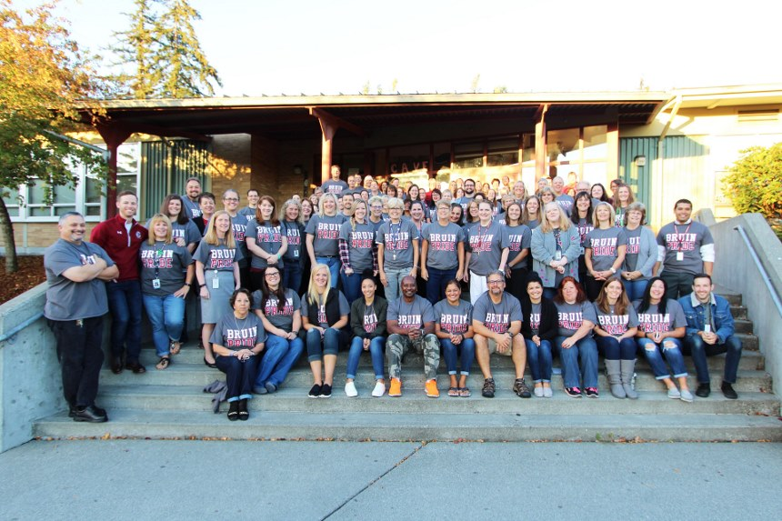
Cascade High School
State of the School Review
2016-17
Notes:
Cathy welcomes

Slide 2
Welcome
Presentation Team
Michelle Crews – English Teacher
Dan Rainey – Science Teacher
Lisa Olson-Kelly – Math Teacher
Kim Taylor and Raj Kleckley – Counselors
Michael Takayoshi – Asst. Principal
Robert Aguilar – Asst. Principal
Matthew Bennett – Asst. Principal
Cathy Woods - Principal
Notes:
Cathy

Slide 3
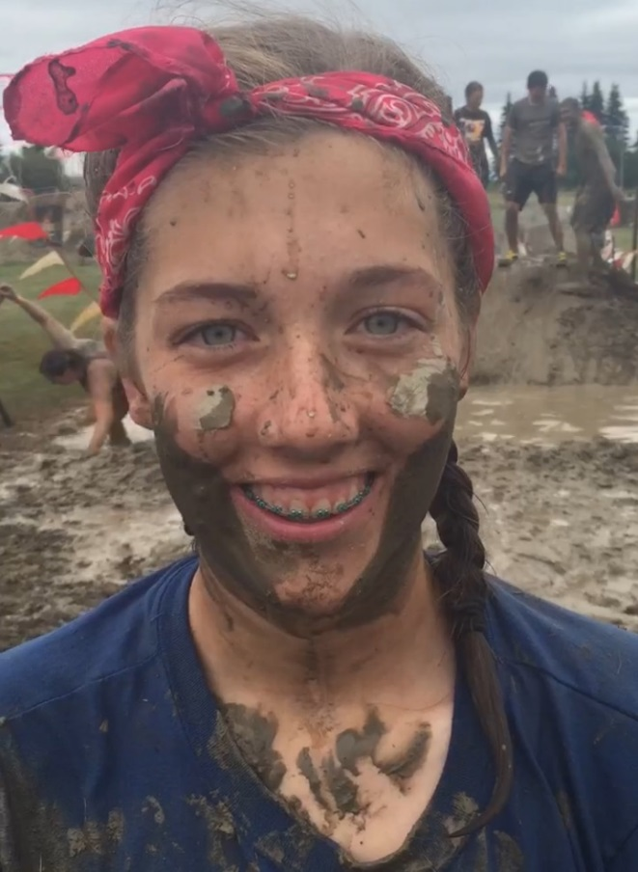

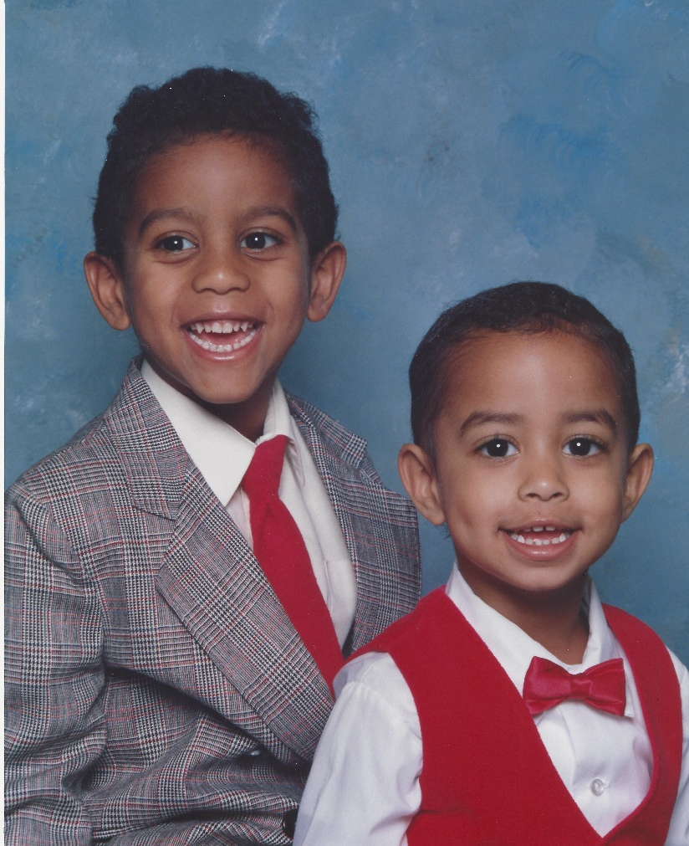
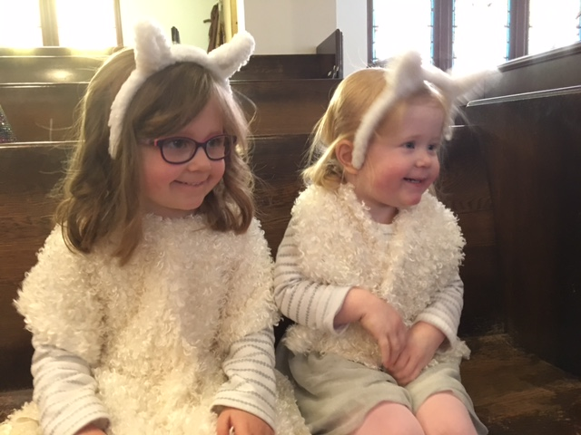
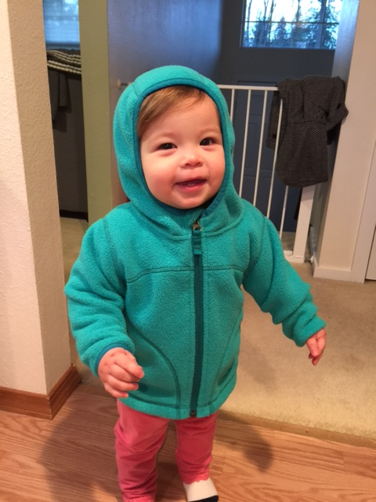
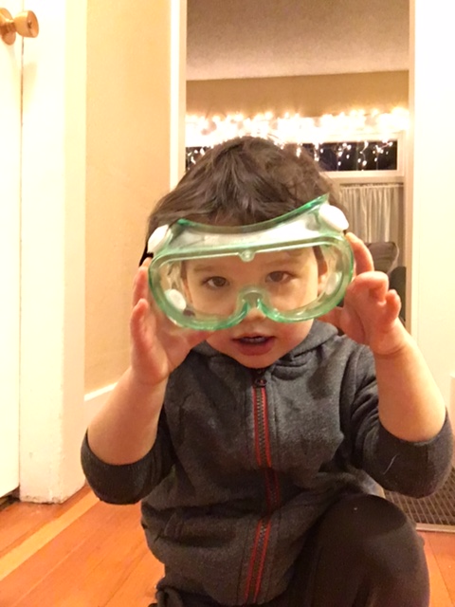
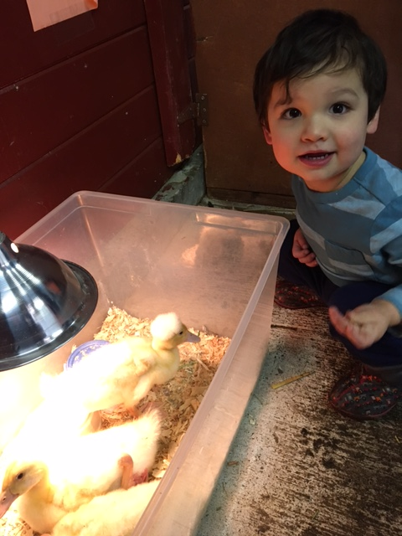
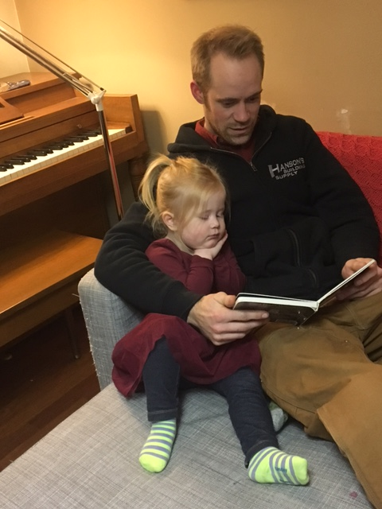
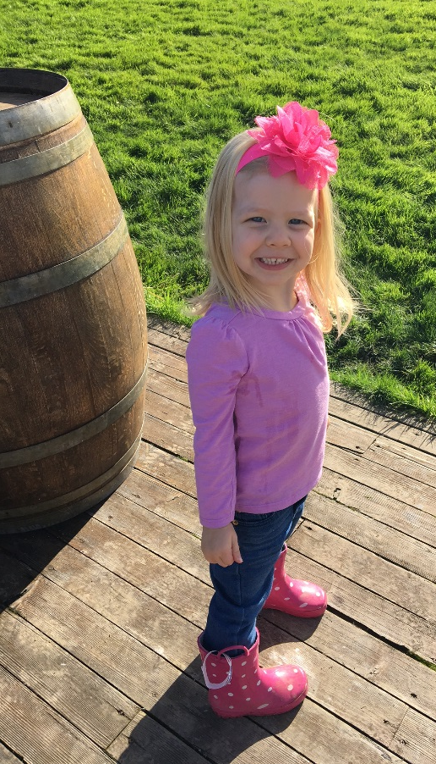
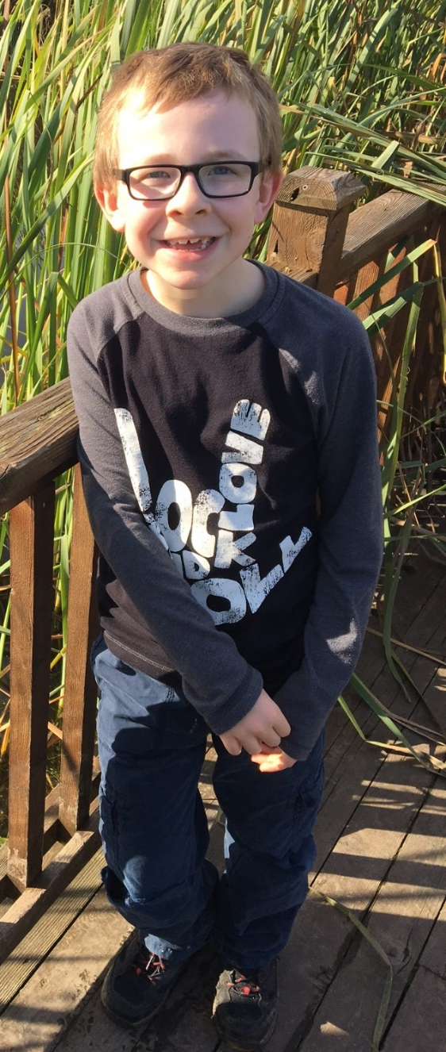
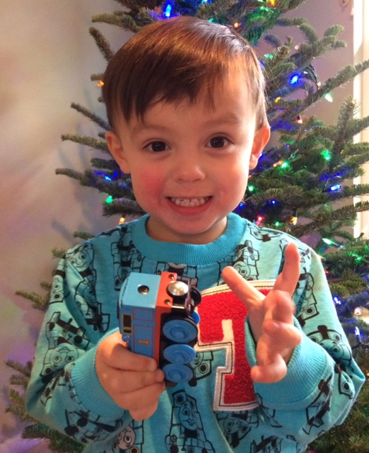

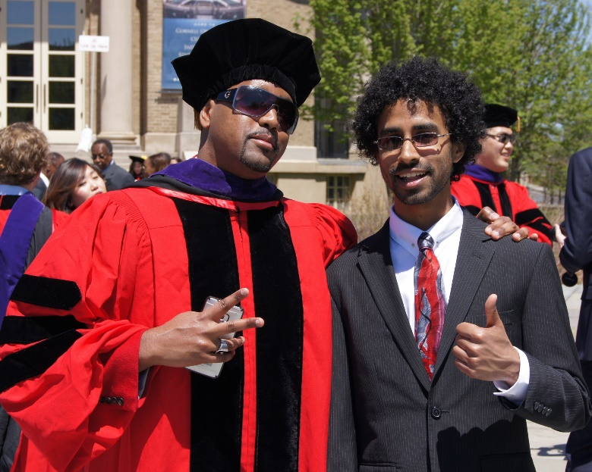

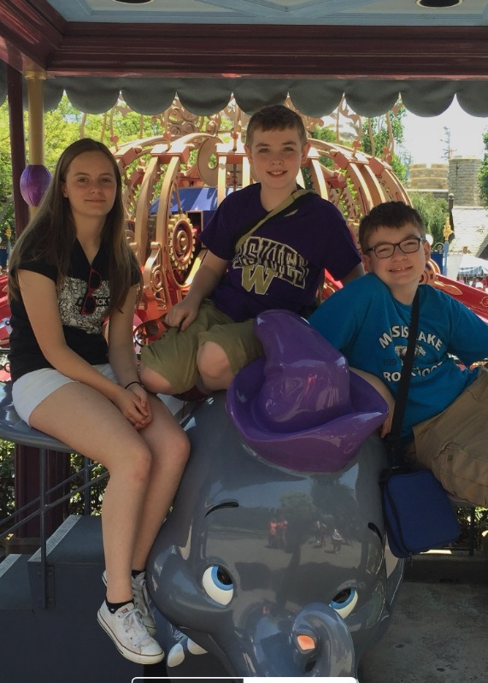
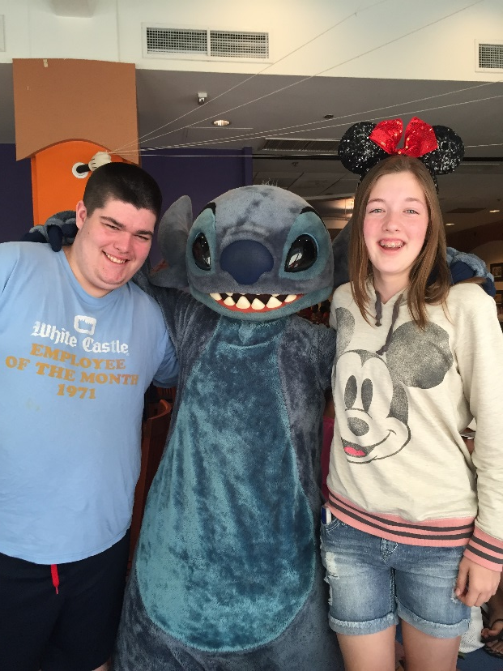
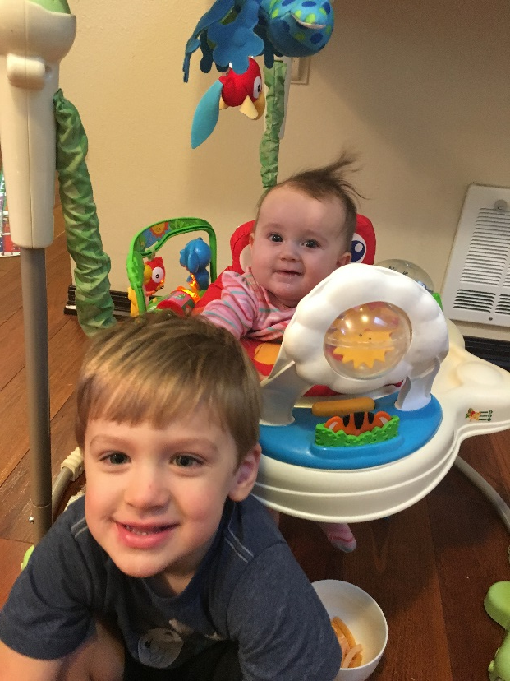
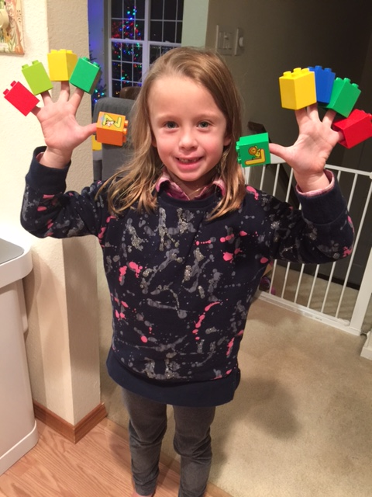
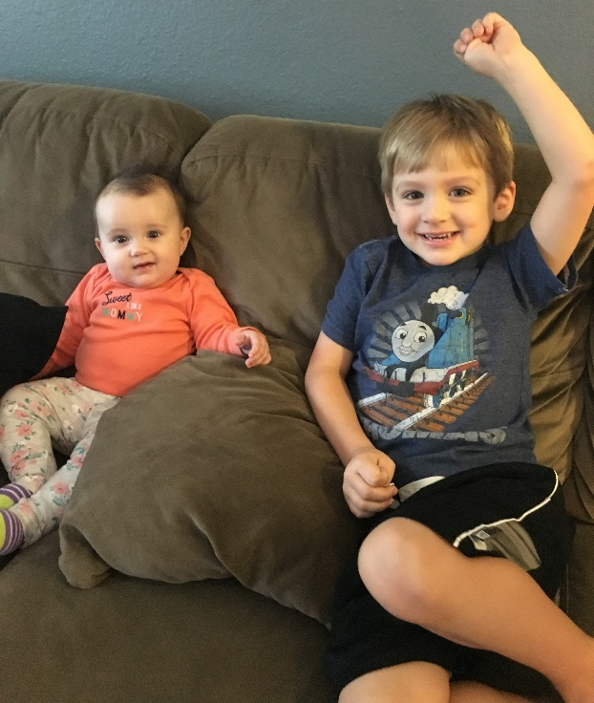

Our Why
“What the best and wisest parent wants for his own child, that must the community want for all of its children. Any other ideal for our schools is narrow and unlovely; acted upon it destroys our democracy.”
-John Dewey in The School and Society, 1907
Notes:
Cathy

Slide 4
Continuous Improvement Model
Data Disaggregation | Timeline Development | Instructional Focus
Assessment | Tutorials, Enrichment, and Maintenance | Monitoring
Notes:
Cathy – you should be able to see the continuous improvement model in our work – in the work of high performance academic teams as well as in our Multi Tiered System of Supports (MTSS) that we are developing to address discipline, attendance, and social emotional learning in addition to academics.
At the end, we’ll put this all together.
First, we’ll analyze some “big data”

Slide 5
Demographic Trends
Notes:
CATHY-Changes over the last 5 years: Increase in Latino population. Other groups have had some growth (2+, in particular). Corresponding drop in White.
Increase in Special Ed this year. (178 students last year; 216 this year)

Slide 6
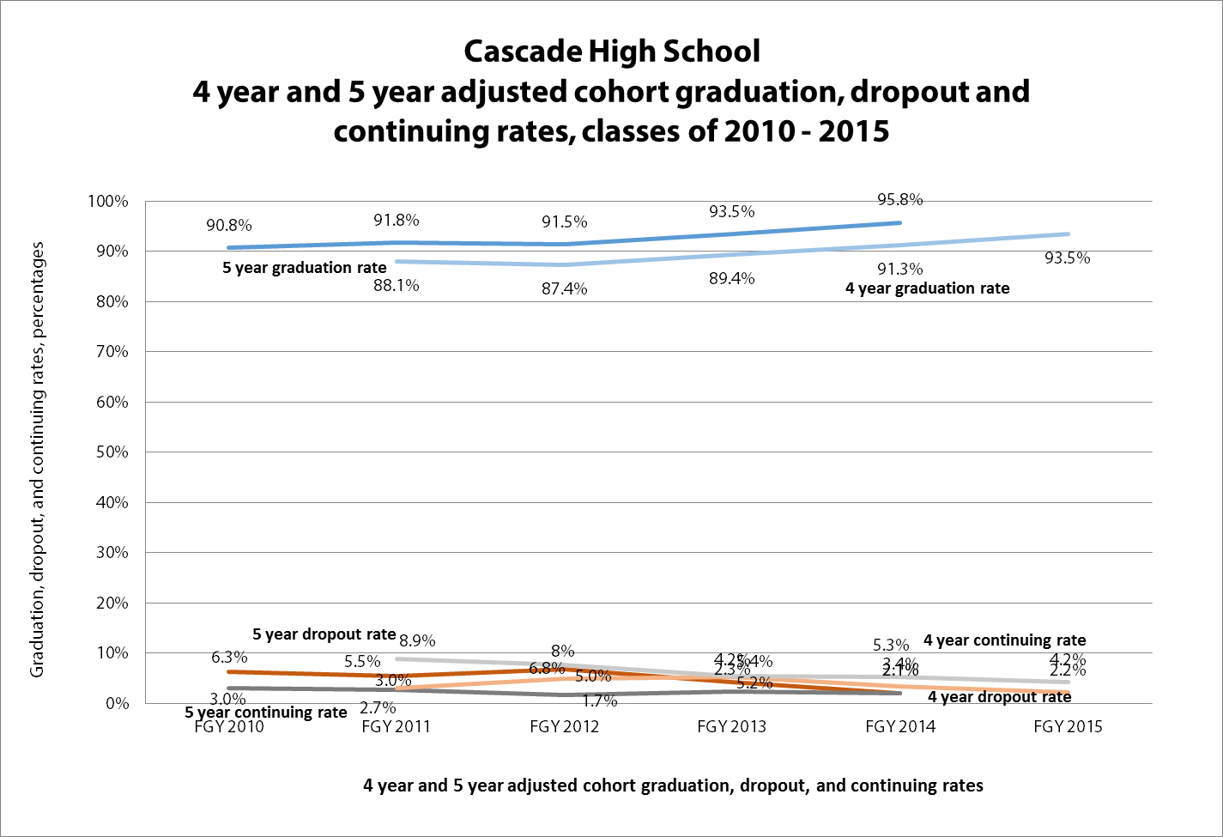
Graduation Rate

Slide 7
2016 Grad Rate vs 5-Year Trend
Notes:
High Graduation rates, but not improving much…hard to do when you are over 90!
Large GOAL cohort this year.
Also, noted that we are still doing so much INTERVENTION – working with students after they have fallen behind. We are using our MTSS approach to better address methods to reduce the numbers falling behind to begin with .

Slide 8
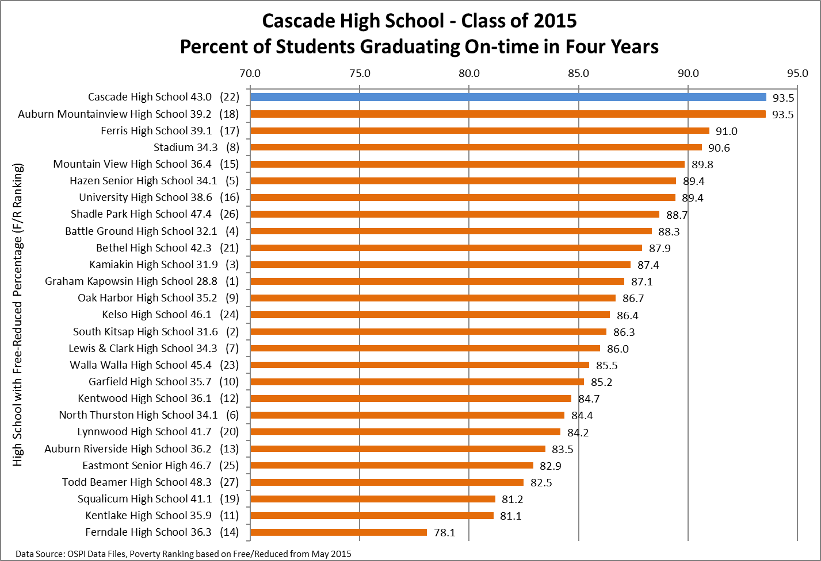
Graduation Rate
Notes:
A celebration, but also a recognition of 1. Hard Work and 2. Significant resources put into this goal at the school and district level.

Slide 9
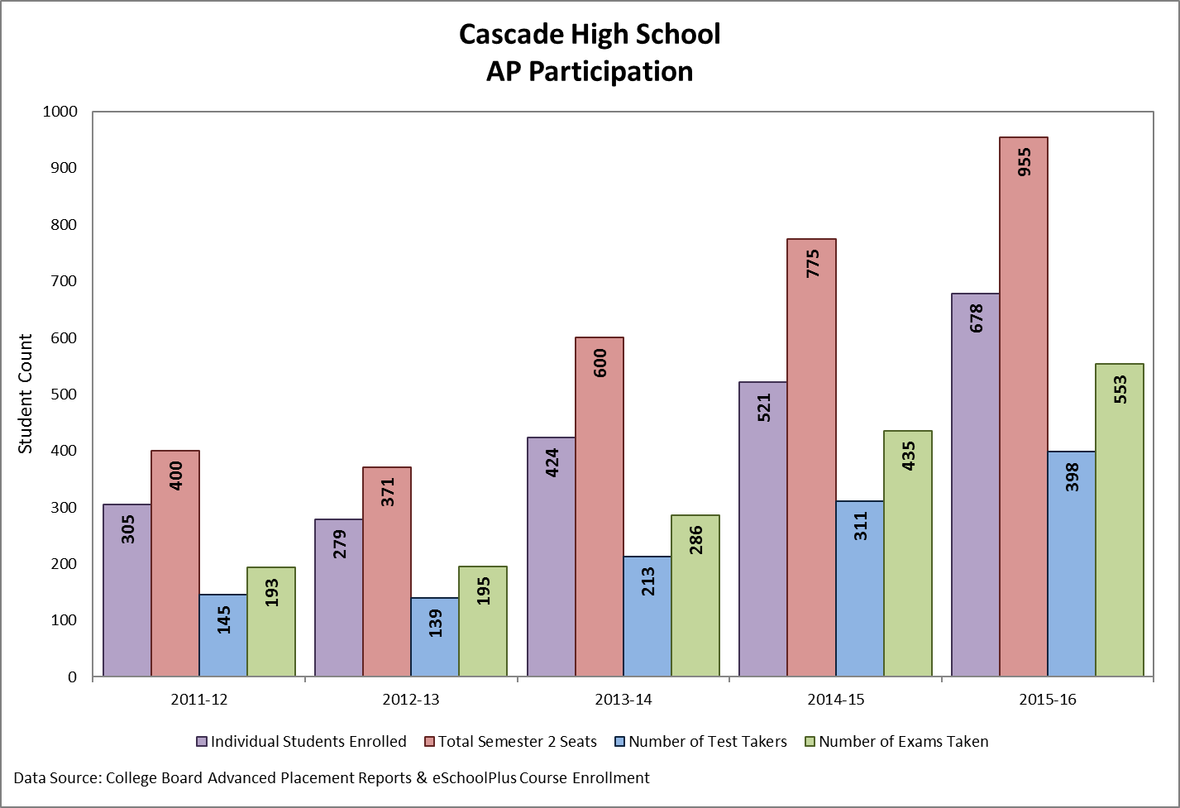
AP Participation
Notes:
Robert – talk about efforts

Slide 10
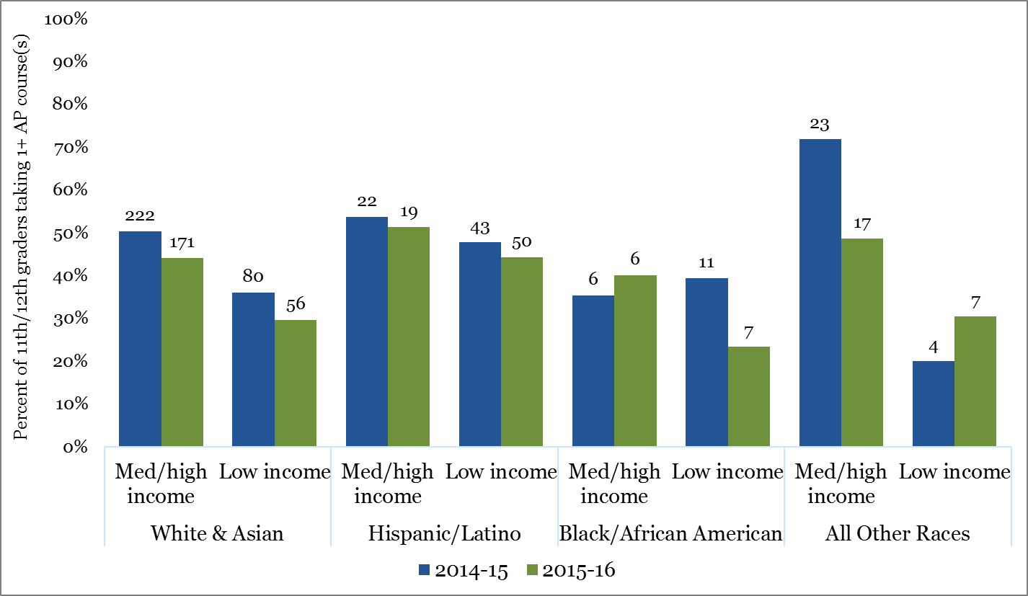
AP Equity Efforts
Notes:
Robert – why did we see dips – efforts include more than 11th and 12th grade.
There is not a student who qualifies that we did not personally invite and encourage.

Slide 11
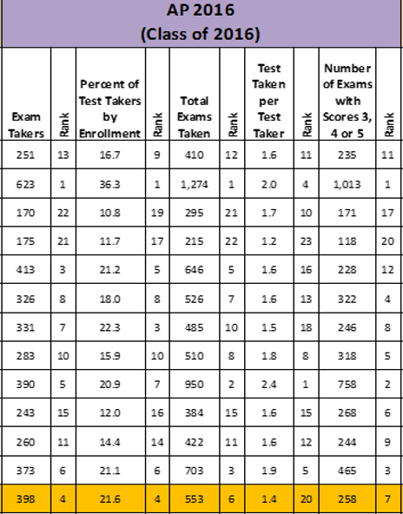
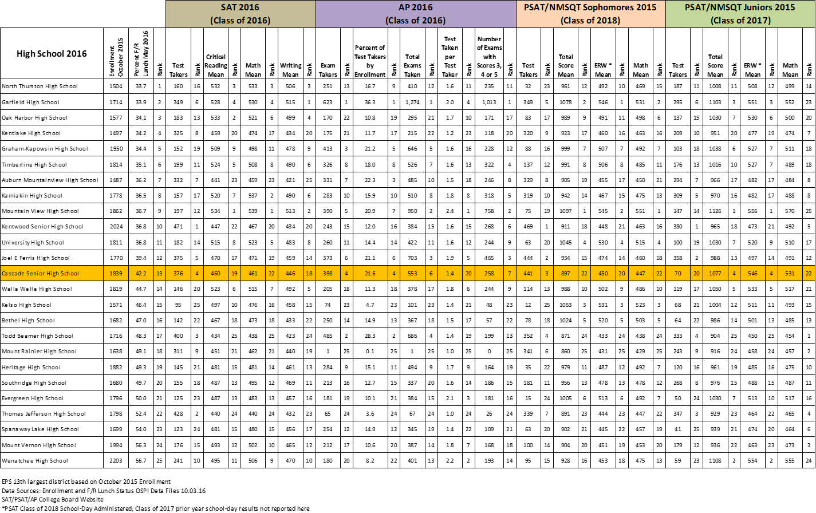
College Board
Notes:
Robert – above expected in % and # of test takers, still work to do in # of exams with 3, 4 and 5:
First time test takers
Putting supports in place -

Slide 12
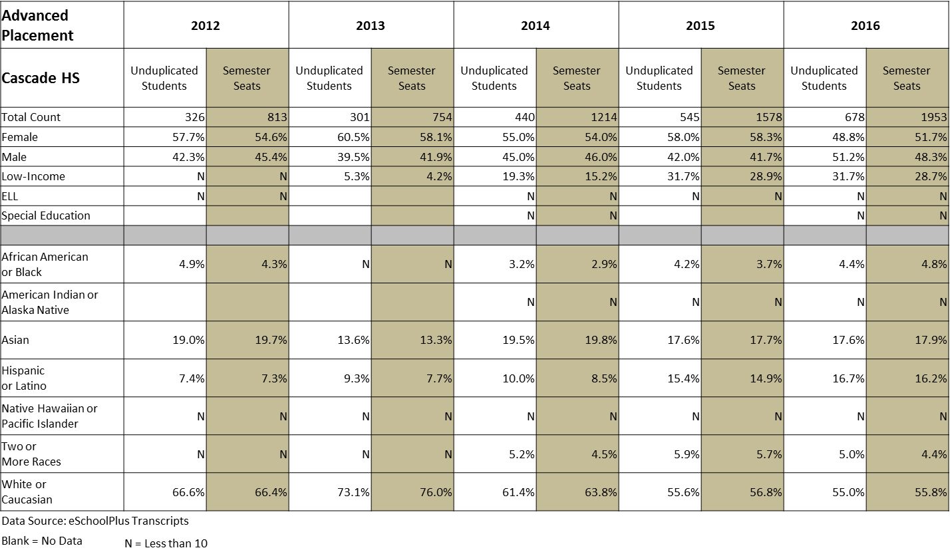
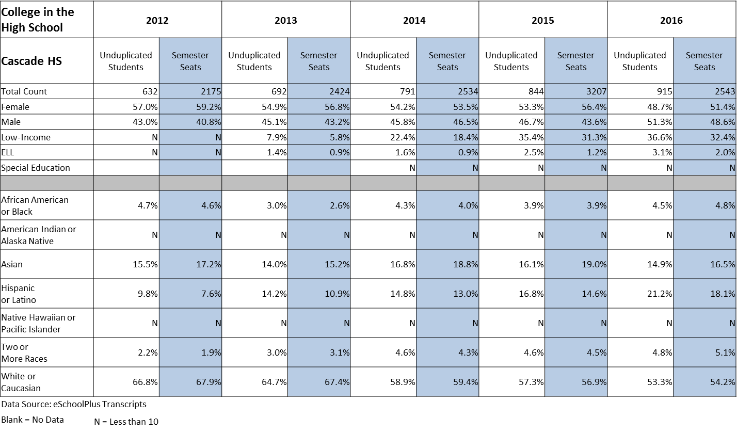
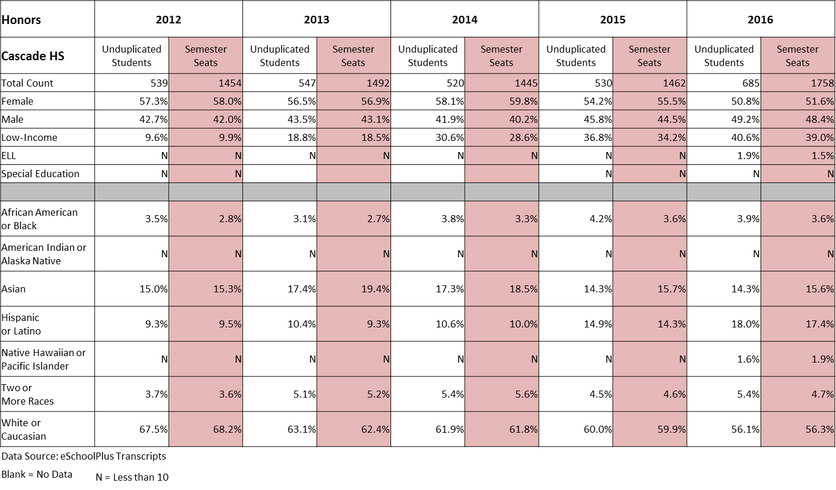
CHART Data

Slide 13
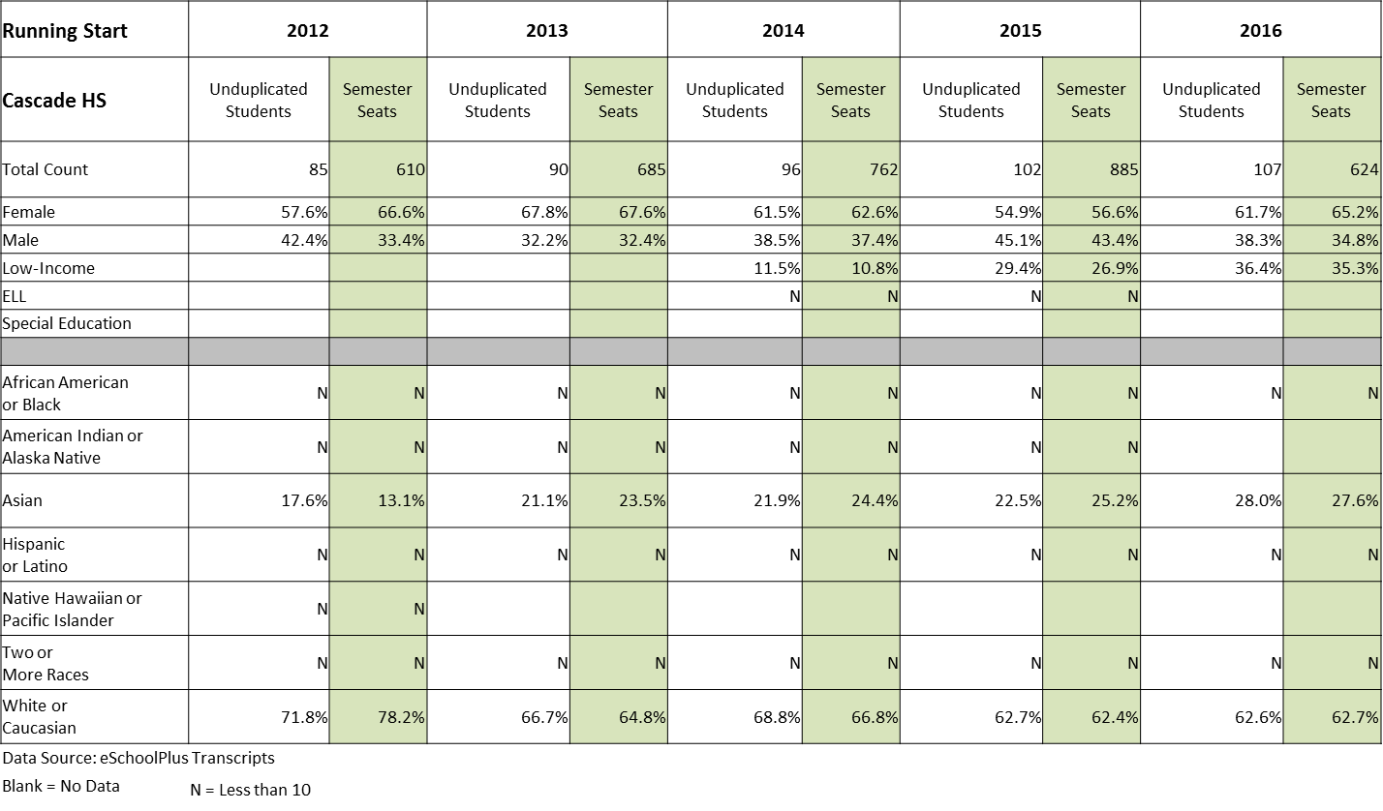
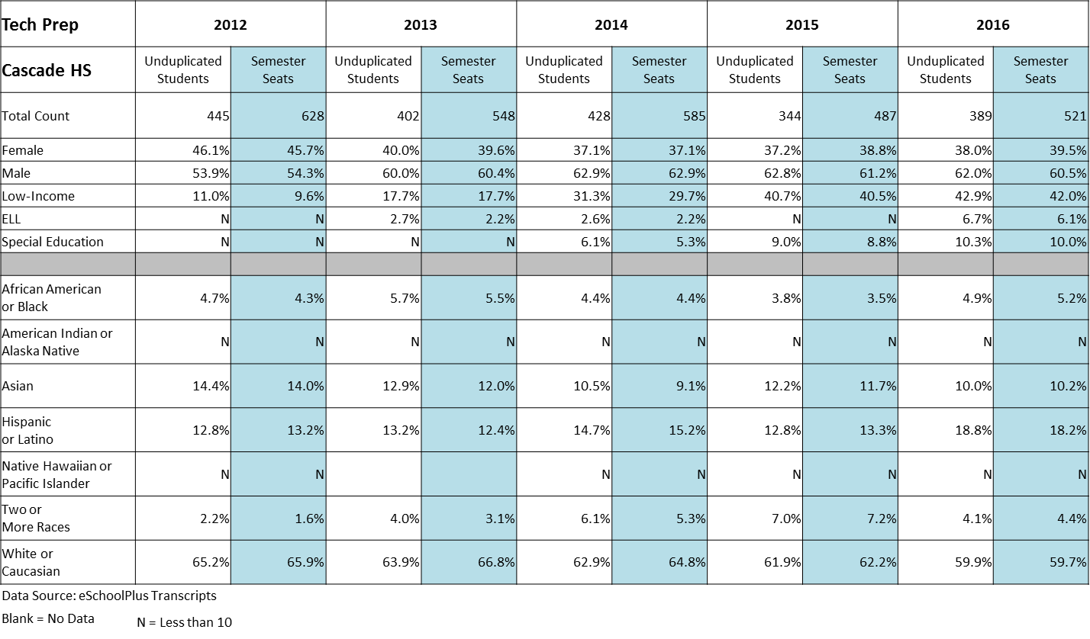
CHART Data

Slide 14
CHART Data
Notes:
Robert – This is college in the high school, but you will see corresponding changes in Honors, AP, Running Start, and to a lesser degree (because it was already more proportionate) in Tech Prep. We have made a CONCERTED effort to recruit students to our challenging options classes and classes bearing college credit to ensure that we are addressing equity gaps in college-readiness.

Slide 15
At a glance
Notes:
Will look at more detail in each content area. Significant areas of celebration, room for growth.
At a glance: Increase in ELA – Familiarity with the format – very large increase in the % of students simply TAKING the test – 2015 saw a large # of students/parents refusing to take the test.
Math – Same reasons for increases, along with better alignment among math teachers, but still have a long way to go. Biology – Disproportionality – African American, Latino students attempted but did not meet standard at a much higher level than White or Asian students. Low income students account for 45% of total students, but 65% of those who have attempted, but not passed the biology EOC. Students who struggled with Bio EOC are also likely to be struggling elsewhere – 67% of those who attempted, but did not meet have failed one or more courses (Yellow or Red). Need more supports, instructional strategies, alignment.

Slide 16

Literacy
Cascade High School
Notes:
MATT

Slide 17
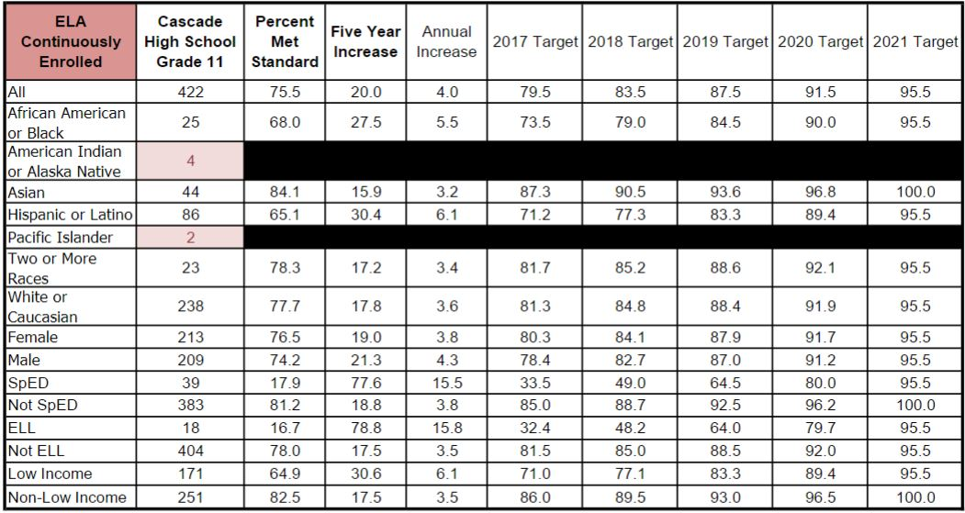
Equity Target ELA
Notes:
Our biggest Equity Gaps we will be addressing mirror our fastest-growing populations: Latino, SPED, and ELL populations.

Slide 18
Literacy Data
Notes:
In response to our 2015 SBA scores for ELA, our English team invested considerable energy into upping the rigor in writing and reading, and this trickled across content areas. In addition, our Sheltered EL courses helped one of our biggest subgroup gains, as you can see here, our Latino population increased tremendously on last spring’s SBA, nearly raising our results back to the levels on the previous HSPE exam, despite the SBA measuring higher standards.

Slide 19
Literacy Data
Notes:
As we increase AP participation across subgroups, our previous SBA gaps behind district and state performance have closed.

Slide 20
Literacy Data
Notes:
A dramatic increase in the number of students tested over the previous year, both because of accountability as well as moving SBA testing to after AP testing, allows our numbers to more realistically measure our student’s levels of performance. ELA teacher increased used of short cycle assessments, as well as utilizing SBA prep has increased the level of confidence for our students testing with the electronic SBA interface, as well as increased analytical response for the more rigorous Common Core standards.

Slide 21
Literacy Data
Notes:
Continued increases in literature-based high leverage strategies, which we will see some examples of, show solid representations of our students meeting College and Career ready standards.

Slide 22
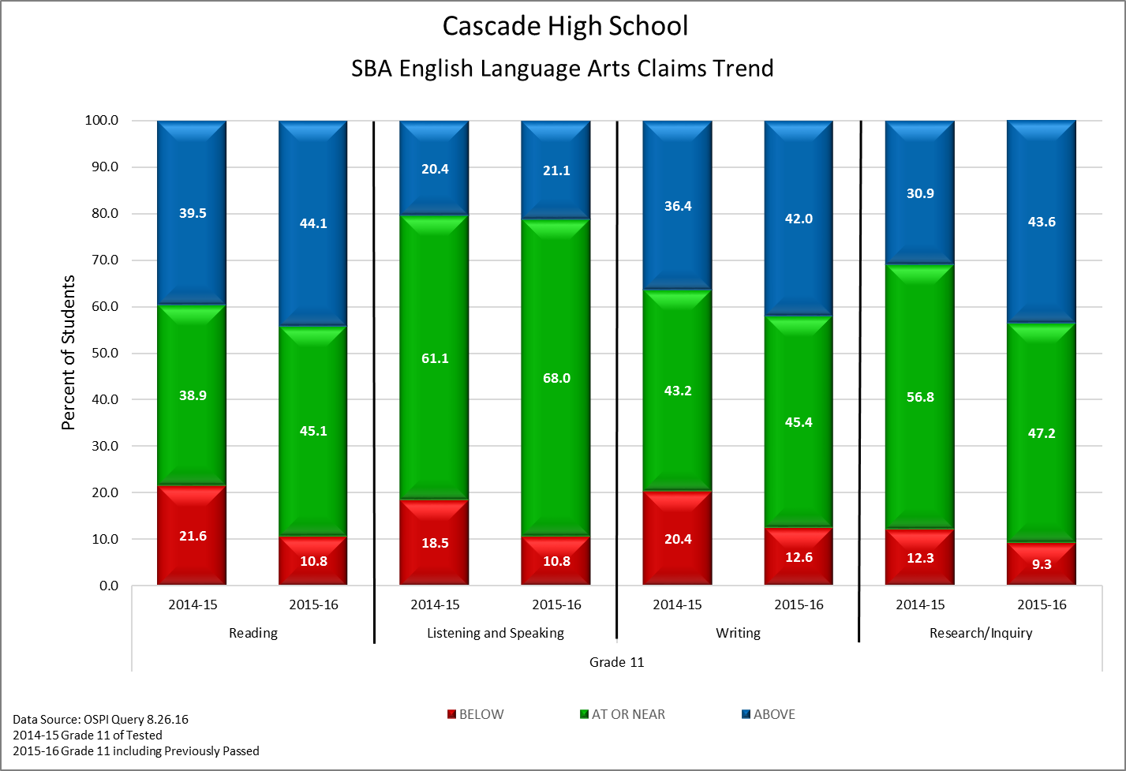
Literacy Data
Notes:
The claims trend represents results of the students who sat for the test. In our first three metrics, we see the gap closing, bringing our next 20% of students to standards. In reading, listening and speaking, and writing, our gains have been predicated by our summer reading challenge, close reading, and an analytical focus on reading and writing, as Michelle will outline.
In research and inquiry, we see a gain in our students above standard, due to partnerships between our library staff and our science, ELA, and SS classes. These teams have produced real-time research units, including info-graphics, opposition research, and collaborative writing.
We are very excited to see our results in the next couple of years as a result of our AP Capstone program, and especially with the advent of 1:1 technology which will increase equity in student access to research tools in and out of school.

Slide 23
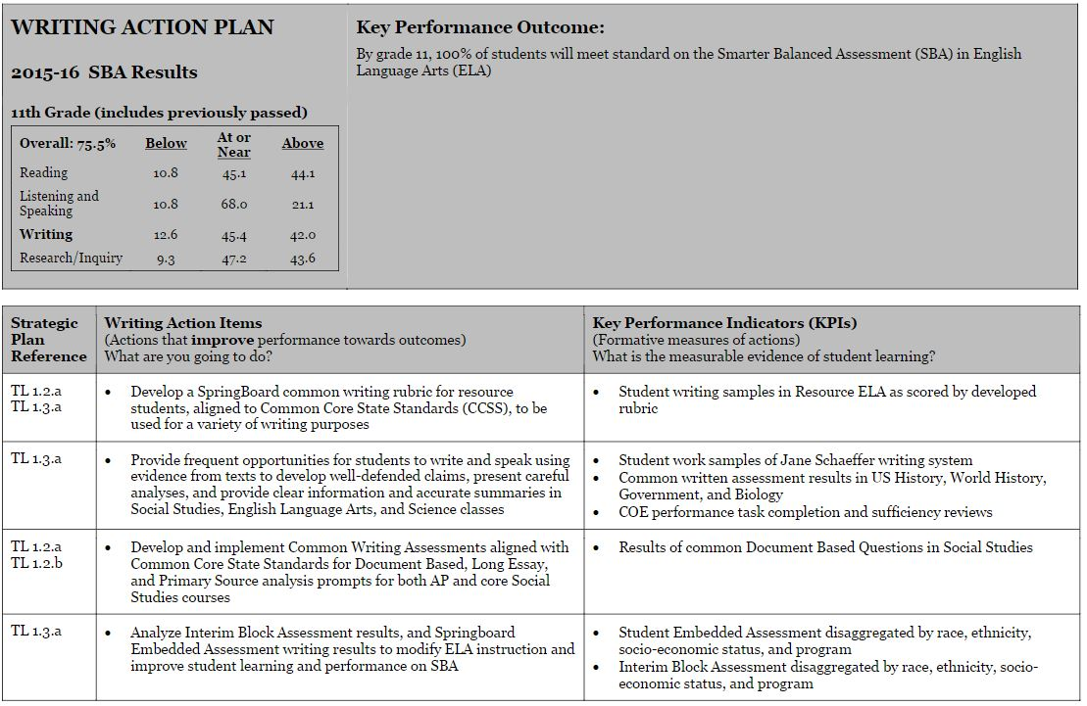
Literacy School Improvement Actions

Slide 24
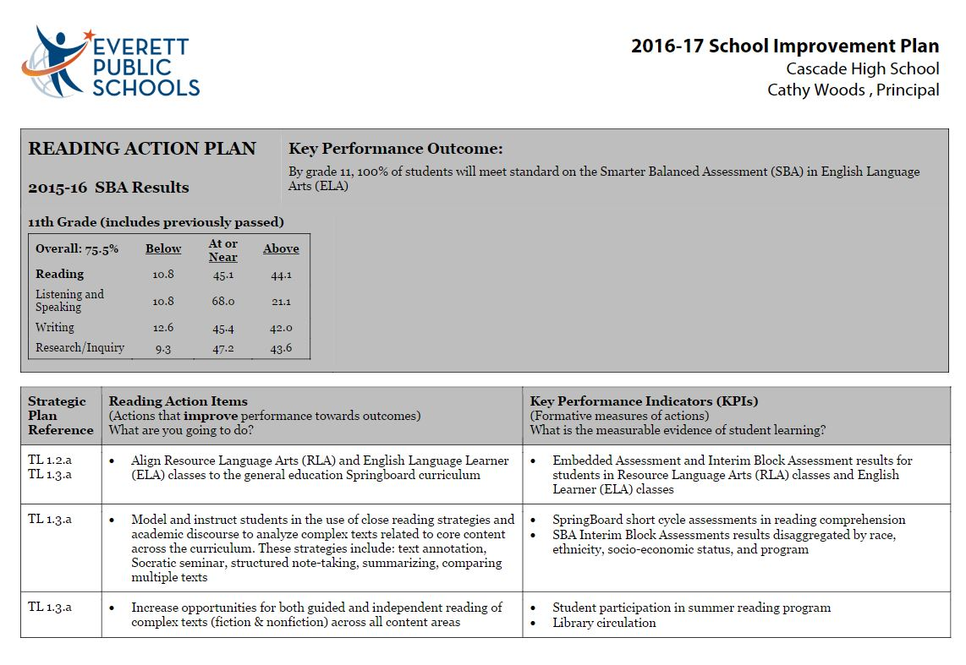
Literacy School Improvement Actions

Slide 25
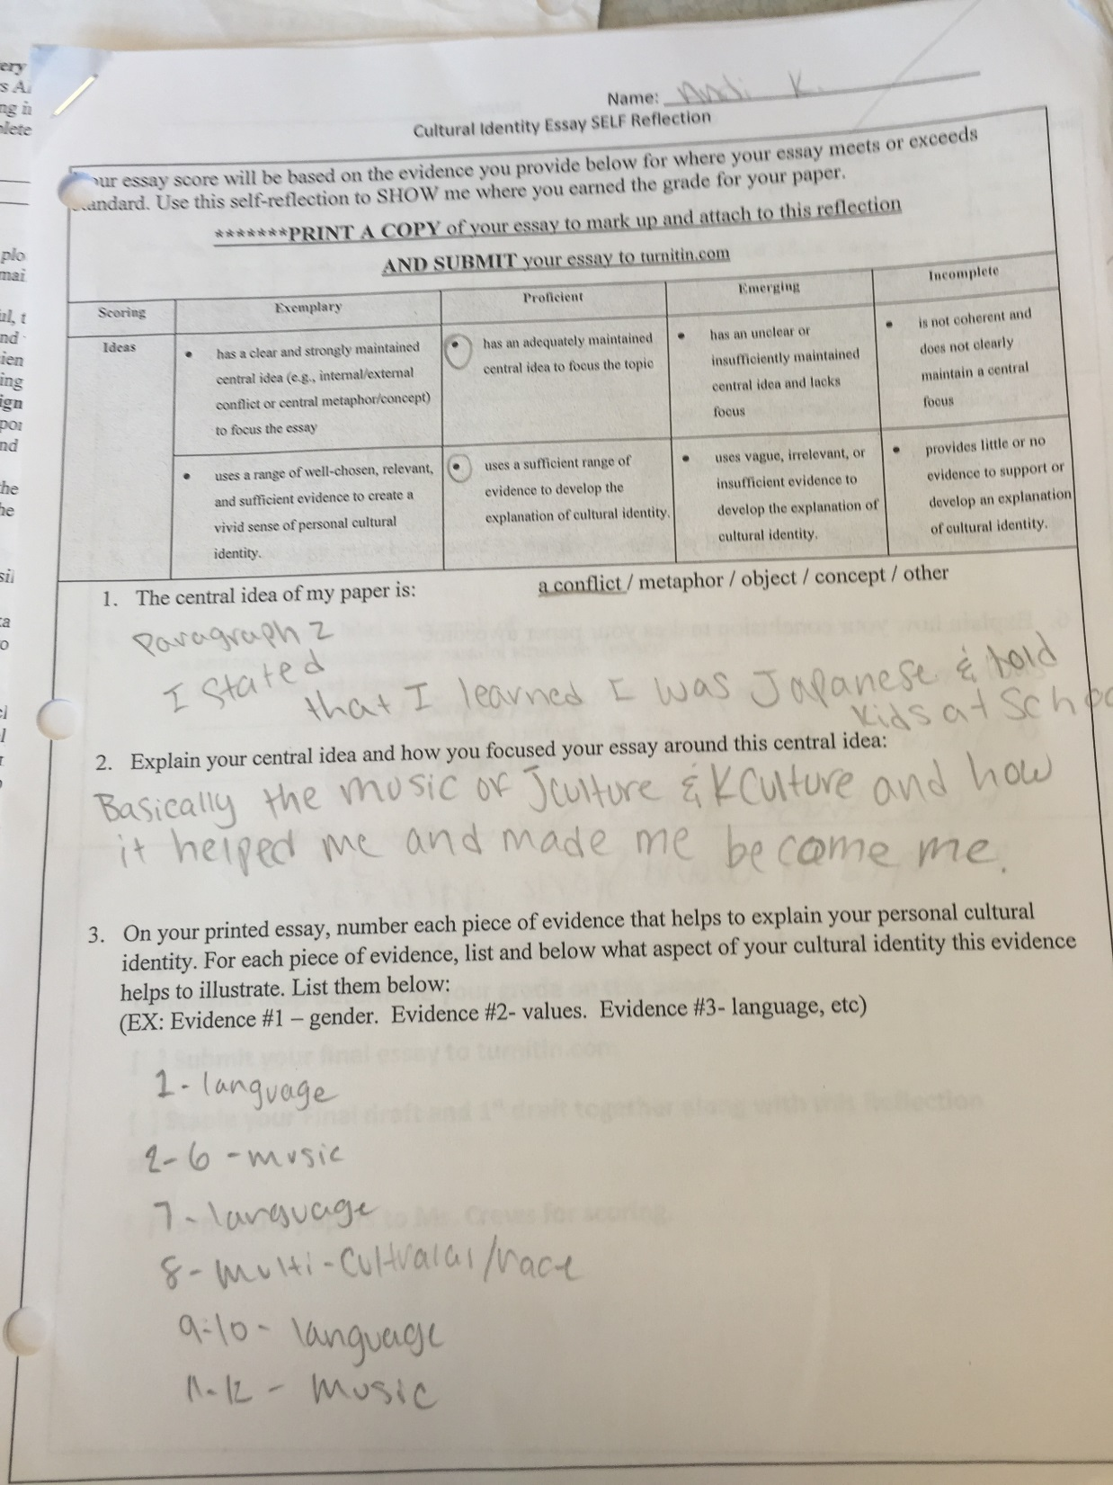
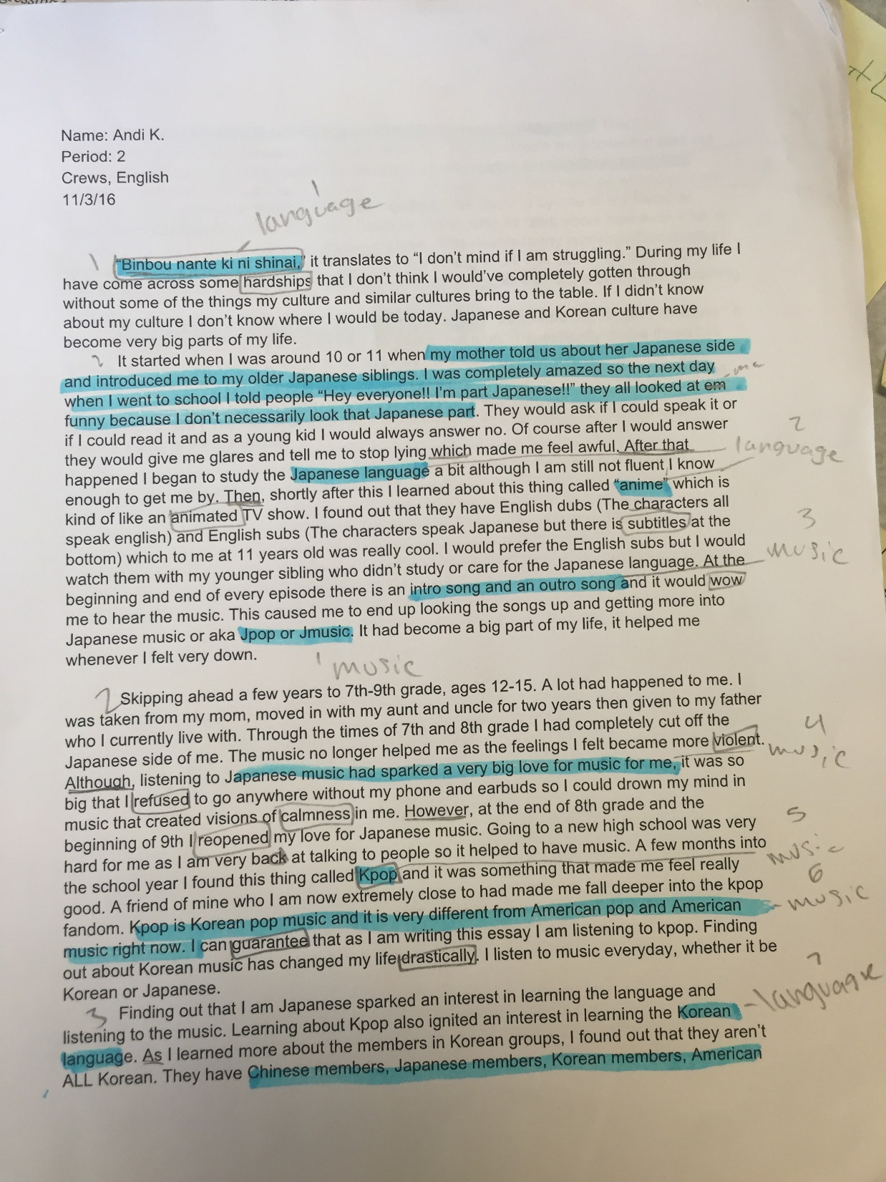
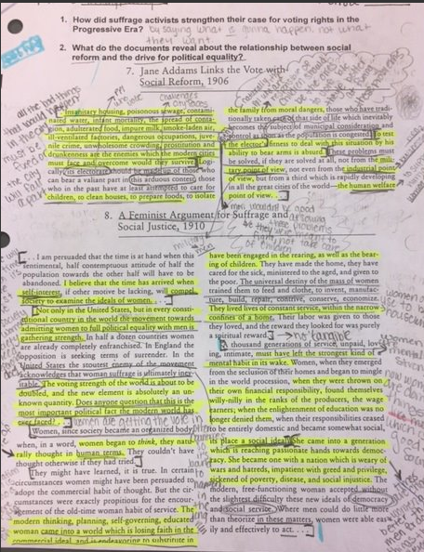
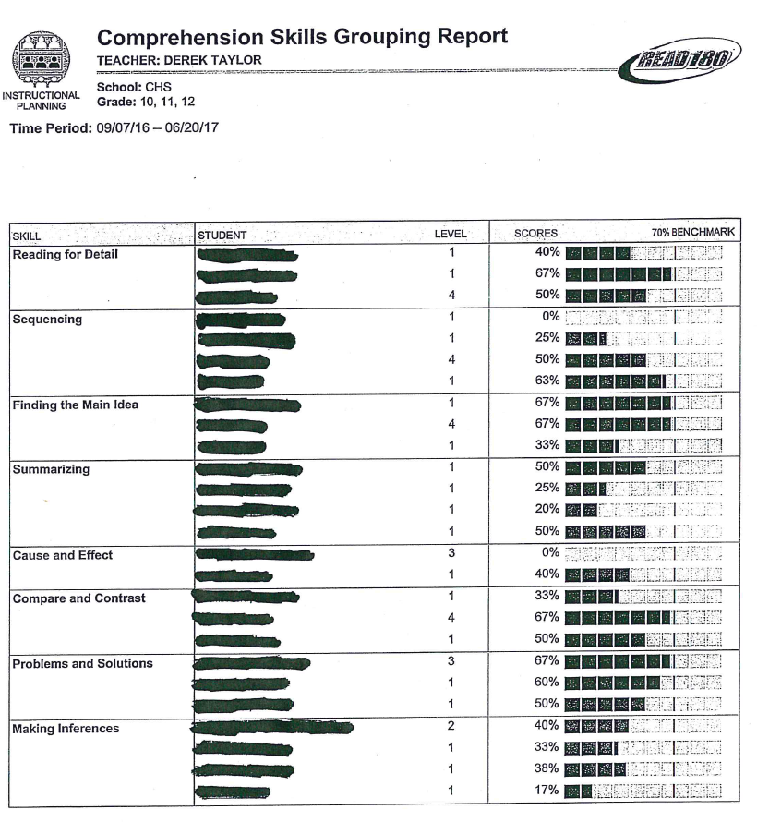
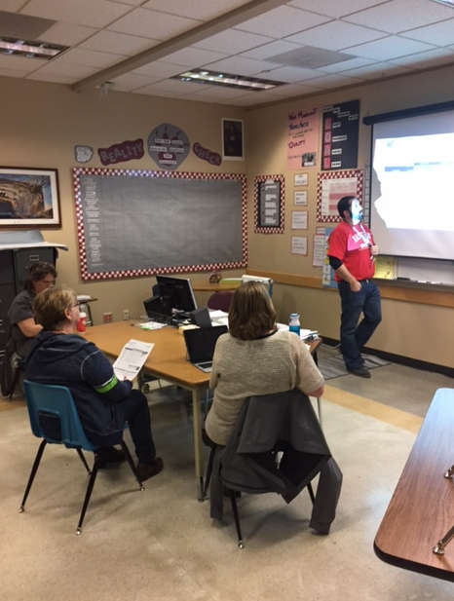
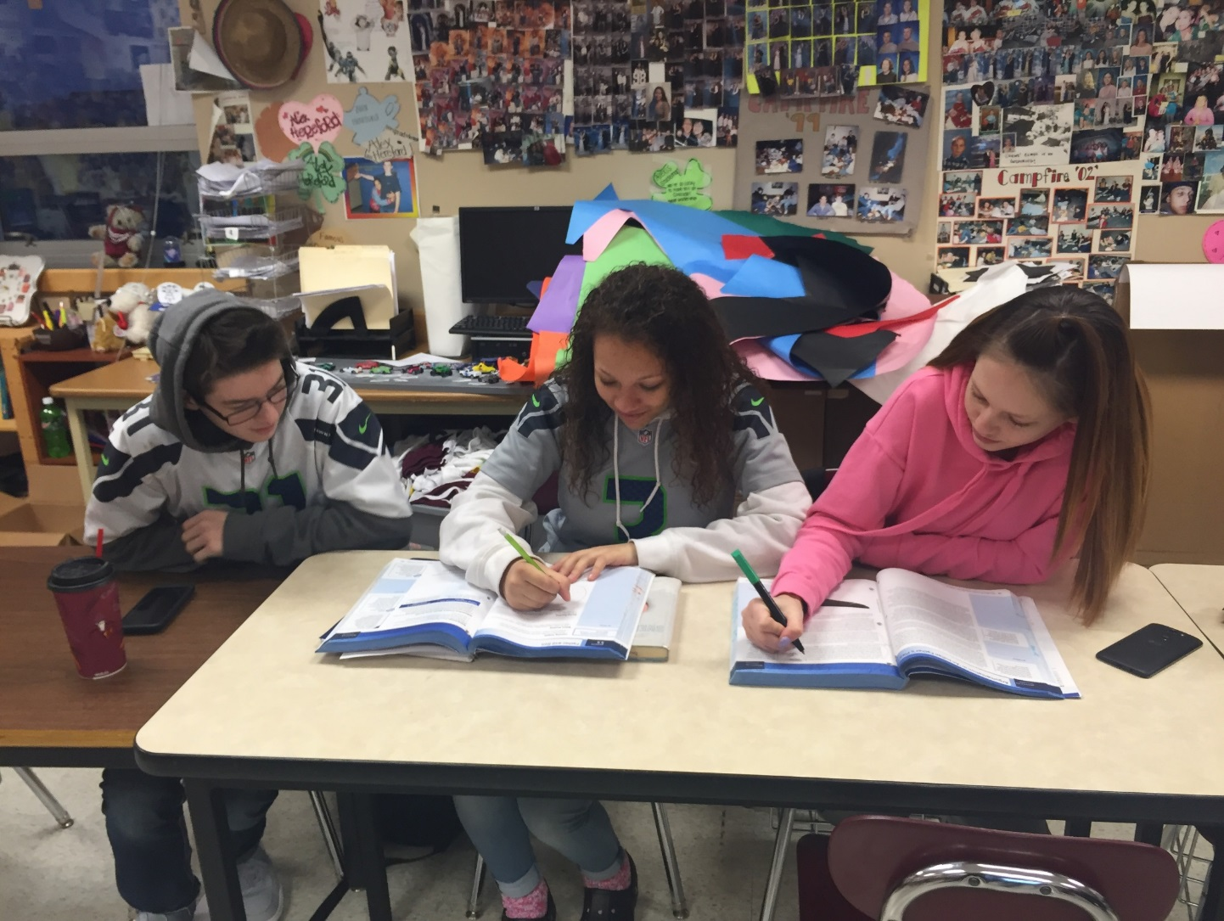
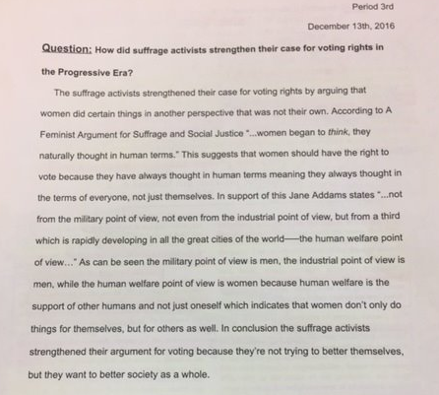
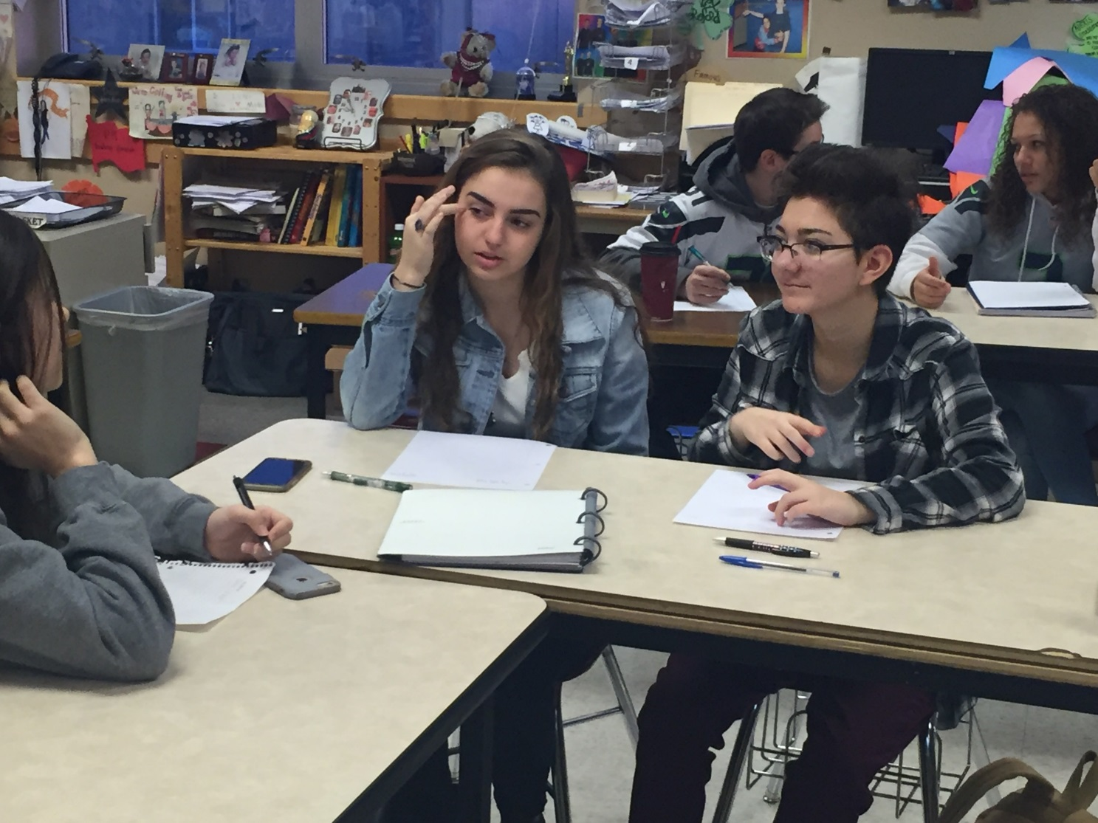
Evidence of Teamwork

Slide 26
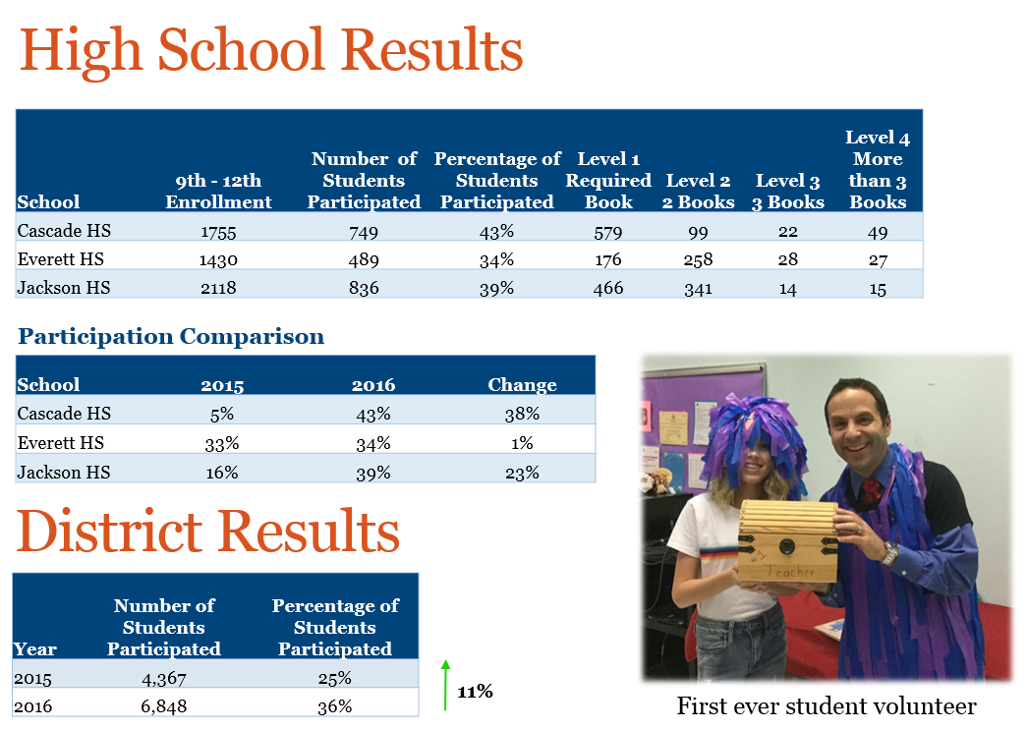
Outcomes (Data) – Summer Reading
Notes:
Our librarian, Amalia, and library assistant Kati, took a proactive approach this year in partnering with our ELA staff in pairing students with books of interest, skyrocketing our Summer Reading participation.

Slide 27
Outcomes (Data) – Library Circulation
Period Ending | Circulation
2016 | 11, 847
2015 | 8, 599
2014 | 9, 115
2017 YTD | 4, 818
2017 Projection | 11, 917
Notes:
At last year’s SOSR, we were on track to get to circulation of 10,500. We far exceeded that due to our June checkout of summer reading books. This year, we are on track to circulation of 12,000, with the goal that each of our students will leave for summer with at least one book in hand.

Slide 28

Math
Cascade High School

Slide 29
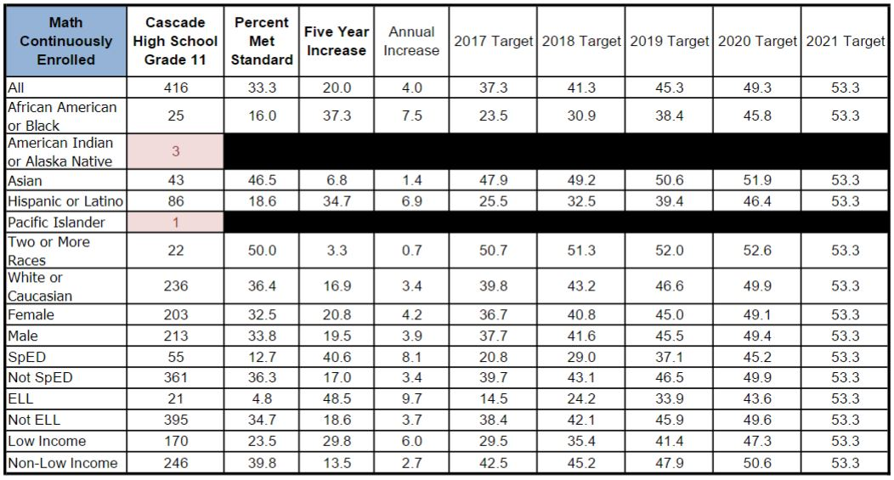
Equity Target Math
Notes:
Michael – Desire to improve holistically from only 1/3 meeting standard. Why: Growth from Spring of 2015 is primarily due to better turnout. We generally have 1/3 of students who do well (advanced track), 1/3 of students who get there with help, and 1/3 who persistently struggle throughout high school. That 1/3 of our student body is disproportionately represented in the following areas as evidenced by our equity targets. Low income, Black/African-American, Hispanic, Special Education and ELL students are overrepresented in that 1/3 of our student body that struggle. We believe these students struggle due to three primary issues: student mindset, which we have strategically addressed more intentionally at the 9th and 10th grade levels, curriculum that is engaging and relevant, which we are working on addressing through better district-wide alignment and resource building, and assessment that are more founded in standards, which you’ll see in the work of our teams this year.

Slide 30
Math SBA Outcomes
Notes:
Michael – Positive increases overall; trending positively. Why: fewer students took the exam in spring of 2015, and with increases in test-takers, particularly among groups of students who had previously opted out, accounts for increases in scores. And while our 2016 scores more than doubled our scores from 2015 and outpacing the state by more than 10% points, they represent real challenge with only 1/3 of our students meeting standard. Our challenges are particularly highlighted by this slide, which demonstrates growth in almost every population, with Hispanic and African American populations being the most modest. Our ELL achievement dropped, which could be explained by significant growth in our ELL population and no direct intervention/sheltered course to support that burgeoning group.

Slide 31
Math SBA Outcomes
Notes:
Our challenges are particularly highlighted by this slide, which demonstrates growth in almost every population, with Hispanic and African American populations being the most modest. Our ELL achievement dropped, which could be explained by significant growth in our ELL population and no direct intervention/sheltered course to support that burgeoning group.

Slide 32
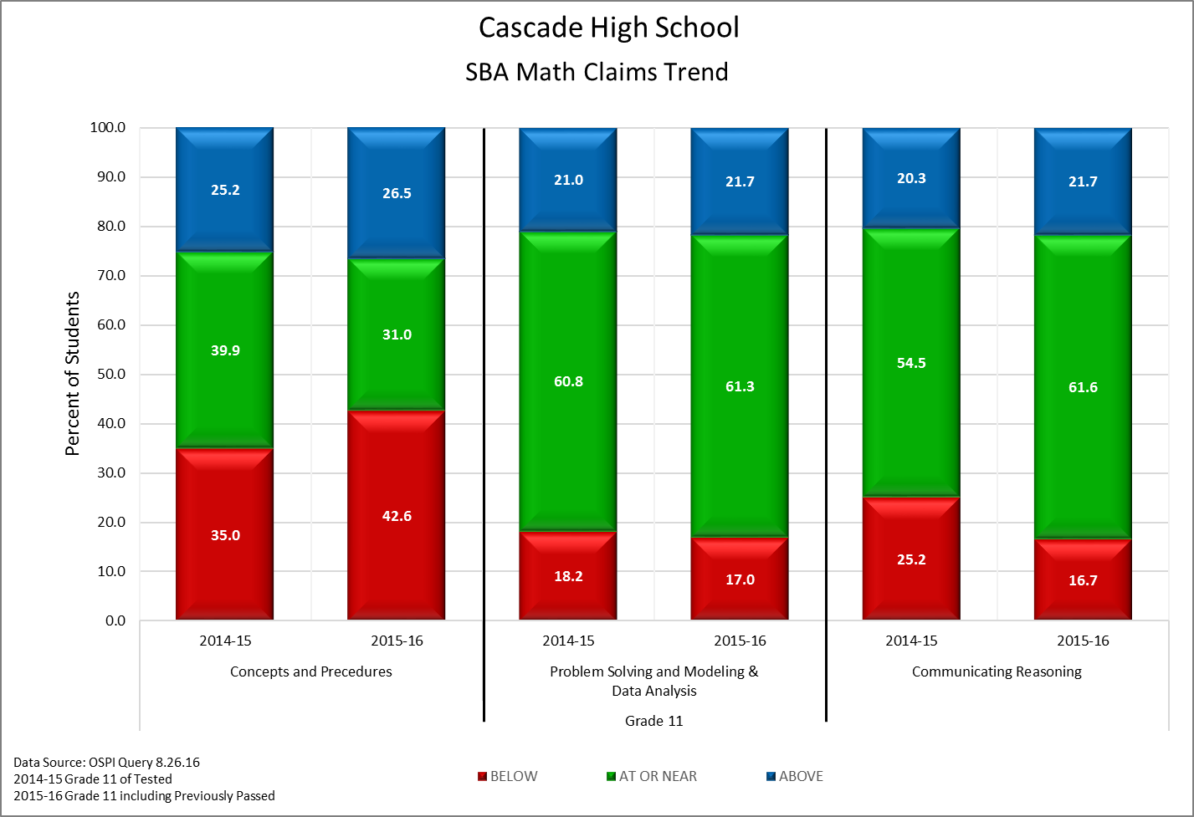
Math SBA Claims Trend
Notes:
Michael – You’ll notice growth in student proficiency in communicating reasoning. Why: Again, fluctuations in data could be due to more students taking the test, but we also believe that this growth is due to our instructional focus the last few years, which has been the wide introduction of AVID strategies, specifically the use of the AVID tutorial process. That process specifically focuses on improving student-to-student discourse, and providing them more opportunity to explain their thinking and in technical courses like math, that has been an instructional shift that has improved student engagement and given students more tools to communicate reasoning. The improvements in that category can be explained, but the reason behind fewer students adequately demonstrating concepts and procedures remains a question for us. Perhaps there is a greater need to structure student discourse to focus on guaranteeing better student understanding of important concepts and procedures.

Slide 33
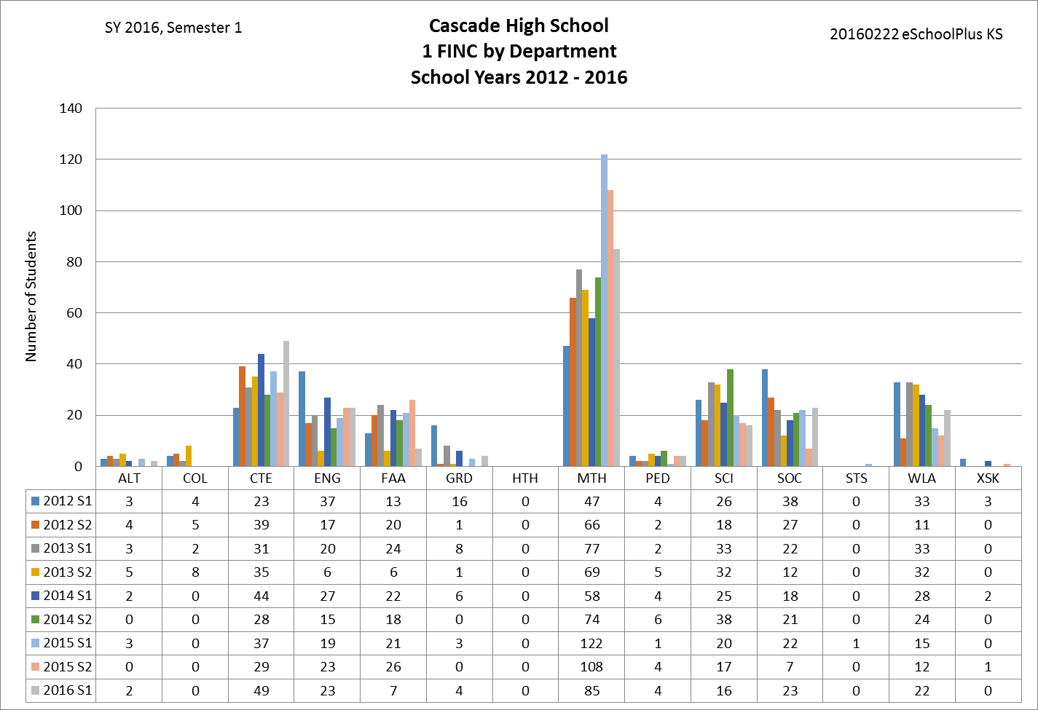
1 FINC by Department
Notes:
Michael – The math department has spend a great deal of time attempting to provide students with highly rigorous content while supporting struggling students. As indicated here, Math has consistently struggled with higher levels of failure than other disciplines. We believe it is because of three primary challenges: student mindset, highly relevant and engaging curriculum, and assessment practices that are not purely standards-based.

Slide 34
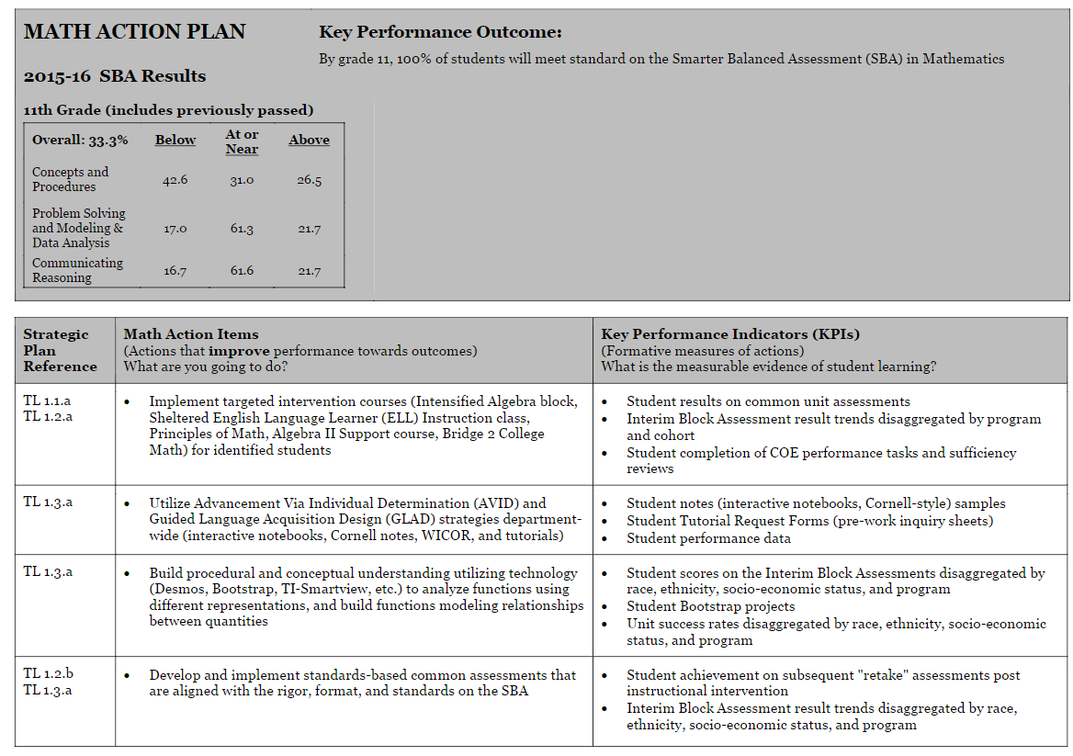
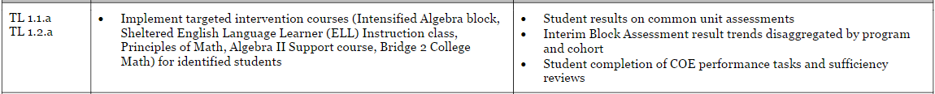
Math School Improvement Actions
Notes:
Highlight: Shifting our planned intervention focus, particularly in terms of scheduling students, from a reactionary model (Modeling Math, Principles, etc.) to a proactive, prevention model (Intensified Algebra, Sheltered ELL, Algebra II Support, etc.). We also want to highlight the building of more accurate and utilitarian assessment practices.

Slide 35
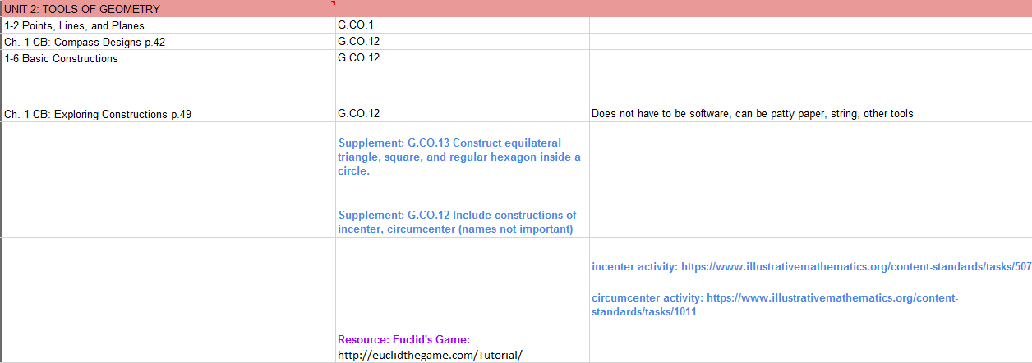
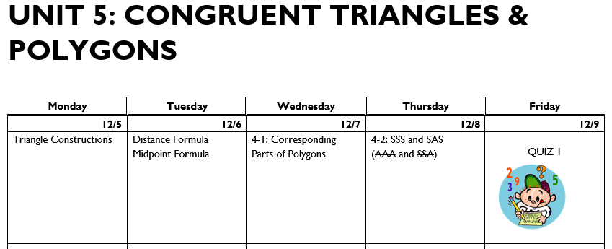
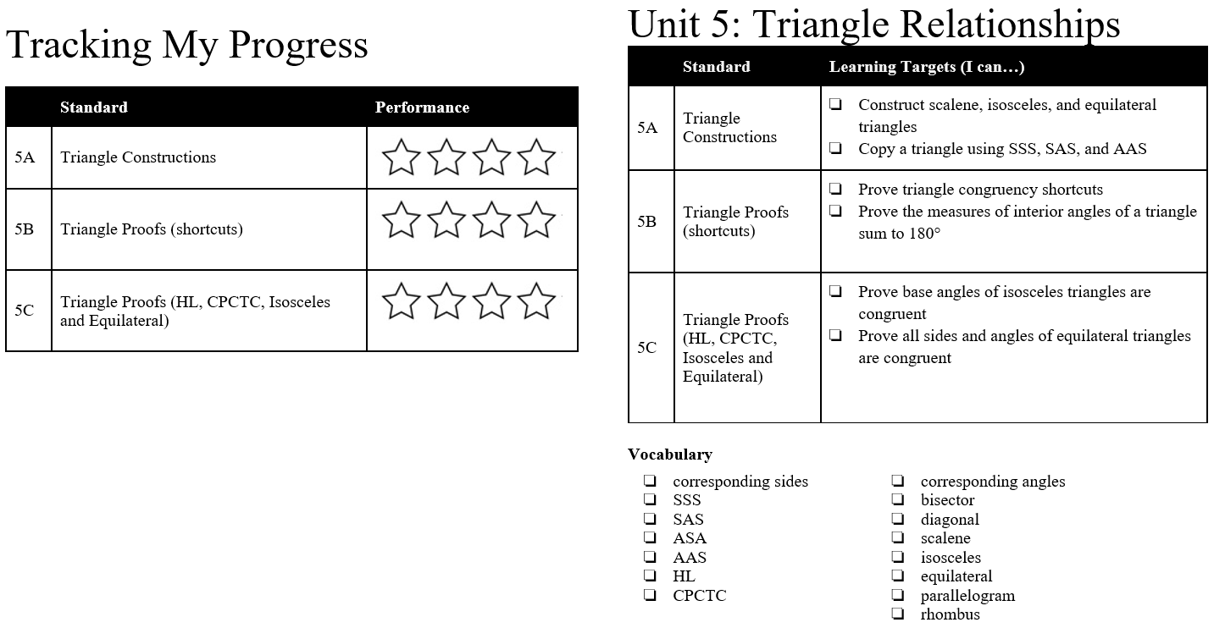
Evidence of Teamwork
Defining Learning Goals
  District wide curriculum mapping to align to Common Core Standards; Smarter Balanced Assessment
    Align each chapter/concept to instructional intervals
    Map out the pacing guide to ensure all standards are given adequate time
    Build common, standards-based assessments, denoting various “levels” or depth of knowledge
Notes:
Lisa – Defining Learning Goals: Shifting from direct alignment to textbook to developing curriculum maps more aligned to expectations defined by Common Core State Standards and Smarter Balanced Assessments. District-wide shift and attempt to collectively build resources and guidelines to teach core concepts, building better resources to increase student engagement through more relevant instruction. What you see here are examples of a planning document used by our Geometry team collaboratively with other buildings to align curriculum, standards, resources and instruction; a document that our Geometry created that helps parse out learning targets for both student and teacher, students would actually use this document to help track their own progress… notice that this document calls out academic vocabulary, we’re seeing academic vocabulary being a very real need among our struggling populations of students; and finally, building instructional calendars off of that work.

Slide 36
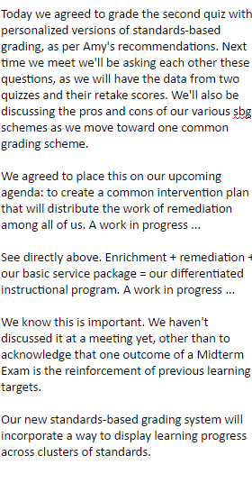




Evidence of Teamwork
Building Rigorous Common Assessments
  District wide curriculum mapping to align to Common Core Standards; Smarter Balanced Assessment
    Build common, standards-based assessments, denoting various “levels” or depth of knowledge
    Formative and Summative assessments used frequently to gauge student understanding of Common Core Standards
    Analysis of student work using data team protocols to identify areas of weakness and strategies for re-teaching/remediation/enrichment
Notes:
Lisa – When looking at the data presented earlier, while students have demonstrated better ability in communicating reasoning, students are needing more work around conceptual and procedural understanding. While our teams have utilized common assessments for the last few years, both Algebra I and Geometry have begun the process of building assessments better aligned to standards and depth of knowledge/leveled. For our struggling students, this accomplishes two things: it removes factors that often disproportionately impact their grades (work completion, the timing of mastery, etc.), and it better defines progress to standard, giving teachers better information to plan remedial actions. These are examples of a leveled quiz with categories for basic, proficient, and an advanced question; various LIF notes of the Geometry team detailing their attempts to better align their assessment practices with a standards-based, leveled approach, which they did with some help from Tavis Miller and Mike Weatherbie, their first semester final exam answer key which now includes topics and difficulty levels, which then gives them the ability to assess more meaningfully.

Slide 37




Evidence of Teamwork
Designing Engaging and Relevant Instruction
  Utilizing data to more adequately define instructional action
    Building engaging lessons using high leverage strategies
    AVID strategies (tutorials, interactive notebooks, etc.); Bootstrap, GLAD strategies
    Specific program needs (ELL Sheltered, Intensified Algebra, etc.) allow for more strategic alignment
Notes:
Lisa – Teams are then utilizing those processes to more effectively build instruction that meet the needs of students. The Math department has prioritized AVID and GLAD strategies the last few years, and now, nearly all of our Math department utilizes the AVID tutorial process and interactive notebooks to help support struggling students more meaningfully. Our intensified course options like our new Sheltered ELL or our Intensified Algebra I classes directly work on implementing strategies to positively reach our struggling students: directly teaching academic vocabulary, integrating growth mindset into their curriculum, building strategies that they then take to the larger Algebra I team to implement more widely. You see here an example of an interactive notebook, an example Intensified Algebra I lesson that has students using Chromebooks to experiment with a distance over time growth model, pictures from our Algebra I classes working with Bootstrap Math, which Algebra I district-wide did to contextualize Algebra I concepts with coding, and an example of some academic vocabulary work in our Sheltered ELL class.

Slide 38
Algebra I Data
Notes:
Michael – Some of the outcomes we’ve seen have been positive. We’ll use Algebra outcomes to start. This first graph demonstrates Algebra I grade distribution for the last 5 semesters. Know that the final breakdown was taken a week ago, and generally outcomes get better when final grades are submitted. You’ll see holistic growth which we believe is due to more specific intervention coursework, and specific strategies we are taking, like integrating growth mindset instruction into Algebra I, better defined assessment practices, directly teaching academic vocabulary, etc. The next graph shows Algebra I grade distribution in our equity target groups at the end of 2nd semester last year, we’ve added males because they are also disproportionately represented, not holistically, but within that struggling 1/3 of our student body. The final graph here shows those same groups this year, which you should see, nearly every group with fewer students failing, but still clear issues with disproportionate representation.

Slide 39


Intensified Coursework
Notes:
Michael – We now have roughly 100 students taking courses that are specifically designed to support struggling students. You’ll see demographically, that a vast majority of those interventions have been for upperclassmen because that is where our focus has been, we’ve been more reactionary than proactive/preventative. We are intentionally building more capacity to intervene with 9th graders with

Slide 40

Science
Cascade High School

Slide 41


Science Data
Notes:
Focus on students taking 3 science

Slide 42
Science Data
Notes:
Why slipping a bit?

Slide 43
Science Data
Attempted, Not Met | Number | % of those Not Met | % of School Population
African American | 14 | 11% | 5%
American Indian | 2 | 2% | 1%
Asian | 13 | 10% | 13%
Latino | 39 | 30% | 21%
Pacific Islander | 1 | <1% | 2%
Two or More | 7 | 5% | 5%
White | 52 | 41% | 54%
Low Income | 83 | 65% | 45%
Special Ed | 22 | 17% | 12%
EL | 28 | 22% | 7%
Notes:
NEED: Work on alignment and instructional strategies that work for an increasingly diverse population. Latino, low income, English Language Learners.
Of the students who did not meet standard, 30% Latino, of those 39 students, 31 were Low income and 10 were also EL’s
The issue is not that our population includes more Latino, low income, or English Learners. The issue is our instructional strategies that need to better meet the students’ need.

Slide 44

Science School Improvement Actions

Slide 45




Evidence of Teamwork
Notes:
The Coordinated Science Team has really worked to incorporate lessons learned from having a sheltered ELL class in Biology (Click 1). They noted through looking at assessment data from their astronomy unit that academic vocabulary seemed to be a problem impeding student success. They developed key vocabulary terms for their chemistry unit and engaged in direct instruction around the vocabulary. They solicited feedback from our biology teachers on what concepts students needed to understand and incorporated that into their instruction
When students continued to struggle, they invited Deb from Categorical programs to work with them (Click 2). They worked together to implement 3 HIGH LEVERAGE ANCHOR strategies:
1. The Use of a PICTORIAL to introduce a new topic
2. A PROCESS GRID
3. A COGNITIVE CONTENT DICTIONARY - providing a visual approach to developing what the vocabulary means in science.
(Click 3)They are now incorporating those anchor strategies into their next unit – Climate and Weather – and will use formative and summative assessments to measure the success of these strategies in improving learning for all students and in closing gaps.

Slide 46


Evidence of Teamwork
Aligning curriculum and teaching practices to NGSS
  District wide curriculum mapping to align to NGSS standards
    Align each standard to one or multiple lessons within the curriculum
    Map out the pacing guide to ensure all standards are given adequate time

Slide 47

Evidence of Teamwork
Using common assessments
  Formative and Summative assessments used frequently to gauge student understanding of NGSS standards
    Analysis of student work using data team protocols to identify areas of weakness and strategies for re-teaching/remediation/enrichment
Chemistry team chose to focus on dimensional analysis after data disaggregation. Notes from administrator-facilitated LIF meeting on 11.04.16

Slide 48

Evidence of Teamwork
Aligning curriculum and teaching practices to NGSS
  From the aligned curriculum, detailed pacing is mapped out at LIF meetings .
    Teachers review unit plan, ensuring standards are addressed.
    Assessments (formative and summative) are placed into the plan to allow teachers multiple assessments of students’ comprehension of the standards.
Plan for upcoming chemistry unit.
Notes from LIF on 12.2.16

Slide 49
Evidence of Teamwork
Using Formative Assessments
Using administrator-facilitated LIF meetings to review student data.
Create proficiency scales together to ensure accurate and consistent evaluation of student work
Analyze data together to see common misconceptions and to identify specific struggling students
Develop plans to help bring these students up to standards.

Slide 50
Outcomes (Data)
Notes:
DAN?
Note some gains because we used the mid-unit assessment to do interventions to ensure more success on the end-of-unit assessment. Still have some work to do.

Slide 51
Outcomes (Data)
 | Pre-Test | Post-Test
1st | 54% | 83%
2nd | 53% | 82%
3rd | 54% | 81%
4th | 48% | 83%

Slide 52
Outcomes (Data)
Notes:
These are results from Carbon Time – Biology team also working on incorporating vocabulary development

Slide 53

Multi-Tiered System of Supports
Cascade High School

Slide 54

Multi-tiered System of Supports
Notes:
Michael – Regarding our systemic supports for students, we have focused on adopted a more intentional process in order to better meet their needs. We are using a multi-tiered system of supports, or MTSS process, to address academic, behavioral, attendance, and which includes team meetings once a week to disaggregate data, plan actions, implement, assess effectiveness, and plan enrichment or continued interventions.

Slide 55

On-time Graduation
Cascade High School

Slide 56

Graduation Rate
Notes:
Over 90% in every ethnicity, program EXCEPT: American Indian (Small N, but still concerning) and Special Ed (goes to increase in programs, and large GOAL cohort). Focus: Alignment of Resource and Gen Ed curriculum; PBIS (Discipline/behavior).

Slide 57

Poverty vs. 2016 Grad Rate
Who are these schools?

Slide 58

Data
Notes:
Currently 16/424 students have submitted FAFSA, but have missing signatures or errors. That’s another 3%, bringing us to 40% if we can get those.
70 students who have not submitted are currently in a CCRS class that will not carry over to next semester (not AVID, AP Gov, or Modified English). Our GEAR UP coordinators and Americorps volunteer are meeting with them.
Of our 27 AVID students, 3 have not submitted, 3 have errors, and one is missing a signature. The rest have all been processed.
64/212 students taking CCRS next semester have processed FAFSA.

Slide 59

Data
Notes:
Currently 16/424 students have submitted FAFSA, but have missing signatures or errors. That’s another 3%, bringing us to 40% if we can get those.
70 students who have not submitted are currently in a CCRS class that will not carry over to next semester (not AVID, AP Gov, or Modified English). Our GEAR UP coordinators and Americorps volunteer are meeting with them.
Of our 27 AVID students, 3 have not submitted, 3 have errors, and one is missing a signature. The rest have all been processed.
64/212 students taking CCRS next semester have processed FAFSA.

Slide 60

On-Time Graduation School Improvement Action Items
Notes:
Michael – In relation to the work we are doing to ensure that student graduation rates are high, especially in regards to graduation credit requirements, one action item that we would like to highlight is our 24 credit pilot plan, which is to develop and implement a very targeted intervention plan to support struggling students.

Slide 61





Evidence of Teamwork: MTSS
Notes:
Kim and Raj – We have utilized the MTSS (Multi-tiered System of Supports) structure to better plan interventions. Our team meets once a week, and spends time reviewing and discussing data in 4 primary areas (Academics, Behavior, Attendance, and Social/Emotional). The goal is to improve the accuracy and reliability of intervention. An example demonstrated here is a greater need for more defined academic study and support opportunities outside of the traditional school day.

Slide 62



Outcomes
Notes:
Kim and Raj – As a result, outcomes include better defined support groups. We have utilized the MTSS process to determine which students and which subject areas have the highest need of intervention. As a result, we are building 4 intervention courses, 3 within the school day, and 1 after school. Coursework will include Why/Try Curriculum designed to re-engage students and direct credit recovery work. We are also attempting to support students by having Math and Science staff members teach these courses due to the high levels of struggle and need for support present in those disciplines. We also have looked at demographics of the 181 students that we determined could directly benefit from receiving academic intervention coursework and support with our 24-credit plan. We are looking to intentionally build these courses to serve our student populations cited in our equity target groupings (Black/African-American, Hispanic, Low SES) as well as build a preventative model that reaches 9th graders rather than react to struggling 11th and 12th graders.

Slide 63

Attendance
Cascade High School

Slide 64




Data
Notes:
You can see our areas of opportunity in attendance mirror our equity targets. As a result, we have changed the philosophy on how we discuss attendance on an ongoing basis. We have morphed our monthly attendance meetings, in which parents and students with 5 or more absences are invited into school. During the meeting, our goal is to build relationships so that each family leave having made a positive adult contact at school, letting them know what resources we can provide.

Slide 65

Attendance School Improvement Action Items
Notes:
Our School Improvement plan outlines our focus to be deliberate, to improve our school climate, and keep students coming to school.
Our Tier 1 supports have involved our leadership students, as well as our Climate and Culture team that Robert will discuss. Through school-wide foci on improving attendance, our weekly cookie drops for on-time classes and a monthly student focus on attendance improvements have reached each of our students, linking students to our intervention services as needed.
As we have brought students back to school, we are recognizing that the social-emotional supports are vital to ensure that students learn the tools necessary to keep them in school each day, ensuring that school is the best part of each of their day.

Slide 66


Evidence of Teamwork

Slide 67

Outcomes
Notes:
We are making gains in creating a positive and supportive culture to get students to school and keep them here.
As a major component of her job, our Administrative Paraeducator, Heather Coon, has invested significant time into home visits, responding to the WARNS surveys, meeting 1:1 with students and parents, and

Slide 68

Discipline
Cascade High School

Slide 69




Data: In-School Suspension

Slide 70




Data: Emergency Expulsion

Slide 71




Data: Suspension & Expulsion

Slide 72




Data: Non-Discretionary Suspension and Expulsion

Slide 73




Data: Discretionary Suspension & Expulsion

Slide 74


Discipline School Improvement Action Items

Slide 75

Evidence of Teamwork

Slide 76

Evidence of Teamwork

Slide 77




Evidence of Teamwork

Slide 78


Outcomes

Slide 79
Outcomes

Slide 80

Social Emotional Supports
Cascade High School

Slide 81

Social Emotional Learning Survey
Participation
  618 students
  Primarily seniors and freshmen
Topics
  Growth Mindset
  School Safety
  Teacher-Student Relationships
  Sense of Belonging
  Grit
  Self Management
  Social Awareness
Notes:
Excited to be able to pilot this survey in fall. Looking forward to results in the spring

Slide 82


Overall Results
Notes:
Surprising because staff is incredibly focused on making connections
More than half of students did not indicate ethnicity/race or gender. Need to ask them to do that specifically. Those who did, not a significant difference except African Americans had higher Teacher-Student relationship scores.

Slide 83







Overall Results
Growth Mindset
Teacher-Student Relationship
Sense of Belonging
Notes:
Look at differences if TIME - ROBERT HOLD UP GREEN if time

Slide 84

Social Emotional School Improvement Action Items

Slide 85

Evidence of Teamwork
19 staff attended Trauma Informed Practices Workshop in November
Equity Matters
Workshop: All staff
Paper Tigers and ACES Presentation
for all staff
Trauma-Informed Practices Consultation
Trauma-Informed Leadership Team
Notes:
Joe Naigle
Heidi Schillinger
Thank you for support

Slide 86





Outcomes
Groups:
Survivors of sexual assault/abuse
Grief
Notes:
Tier 1 – all staff for all students
Tier 2 – for students identified as needing additional support
Tier 3 – for a small group of students needing more intensive interventions.

Slide 87
Continuous Improvement Model
Data Disaggregation | Timeline Development | Instructional Focus
Content teams and MTSS teams meet regularly to disaggregate data, including state assessments, common formative and summative assessments, attendance, discipline. | Using district work on curriculum mapping and CHS content teams, we map our instructional timeline. | Content and MTSS teams use data to determine instructional strategies. We use the resources of instructional facilitators and professional development to guide us in the use of research-based practices.
Assessment | Tutorials, Enrichment, and Maintenance | Monitoring
Results of formative and summative assessments guide our next steps. Classroom assessments Student/staff surveys for discipline, social/emotional learning. | Maintenance: Tier 1 strategies: differentiation in the classroom, re-teaching, PBIS lessons, kernels, freshman finals prep are examples Tutorials: Bruin Success Time, Saturday Academy, PAWS tutoring, credit recovery systems Enrichment: Challenging options, extensions | Interim assessments Regular administrative team walk-throughs LIF notes and feedback
Notes:
Disaggregating data -regular meetings - common classroom assessments for CONTENT, attendance, discipline, surveys, for MTSS
Timeline Development – curriculum mapping as a district
Instructional focus – using data to determine instructional strategies. Resources – Instructional facilitators, LMS team, guide us in research-based practices
Assessment – results guide our next steps in instruction and in tutorials and enrichment
Maintenance – tier 1 strategies – differentiation in the classroom, reteaching, PBIS lessons, kernals, freshman finals prep
Tutorials – Bruin success time, Saturday Academy, PAWS tutoring
Enrichment – challenging options, extensions, acceleration
Monitoring – interim assessments, admin walkthroughs, LIF Notes (example)

Slide 88




Monitoring: LIF Notes
Notes:
We are proud of all our high functioning teams This is an example of LIF notes and feedback. Coordinated science,

Slide 89
Thank you!
Math Support
  Intensified Algebra
  Bridge to College Math
  Alignment Work
  Sheltered ELL Class
Administrative Support Paraeducator
  Extra Hours
On Time Graduation/24 Credit Support
  World Language
  24 Credit Pilot
Alignment Work in Content Areas
Sea Mar Mental Health Support

Slide 90
Supports Needed
Support for Transition to High School for Freshmen/Early Intervention for 24 Credit Requirement
  Additional Sections of Intensified Algebra
  Opportunities for acceleration
Continued Support for Full-time Administrator Support Paraeducator
  Attendance and Social/Emotional Support Teams
  Making Connections
Support for Non-exclusionary Discipline Practices
  Restorative Justice Specialist
Continued Cross-district Collaboration for Content Teams

Slide 91







Our Why
“What the best and wisest parent wants for his own child, that must the community want for all of its children. Any other ideal for our schools is narrow and unlovely; acted upon it destroys our democracy.”
-John Dewey in The School and Society, 1907
Notes:
Cathy

Slide 92
Thank you
Cascade High School

